Slide 1
Cushing Syndrome
Dr. Monir Hossain
Associate Professor
Department of Medicine
Shahabuddin Medical College Hospital

Slide 2
Cushing’s syndrome is caused by excessive activation of glucocorticoid receptors
It is most commonly iatrogenic, due to prolonged administration of synthetic glucocorticoids such as prednisolone
Endogenous Cushing’s syndrome is uncommon but is caused by chronic over-production of cortisol by the adrenal glands, either as the result of
        An adrenal tumour or
        Excessive production of ACTH by a pituitary tumour or
        Ectopic ACTH production by other tumours

Slide 3
Aetiology
Amongst endogenous causes, pituitary-dependent cortisol excess (by convention, called Cushing’s disease) accounts for approximately 80% of cases
Both Cushing’s disease and cortisol-secreting adrenal tumours are four times more common in women than men
In contrast, ectopic ACTH syndrome (often due to a small-cell carcinoma of the bronchus) is more common in men

Slide 4
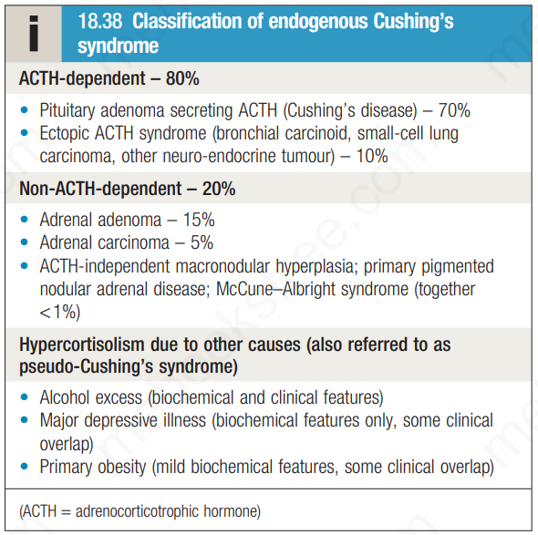

Slide 5
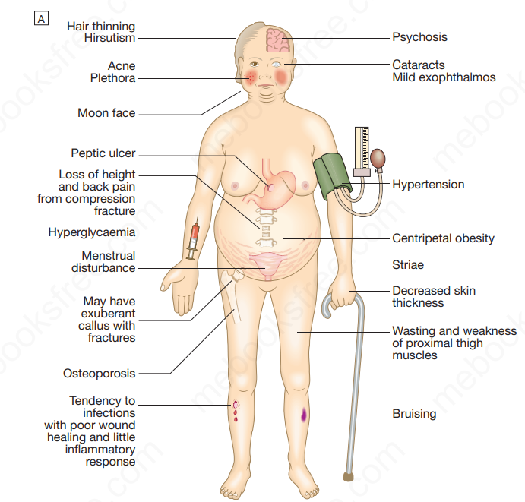

Slide 6
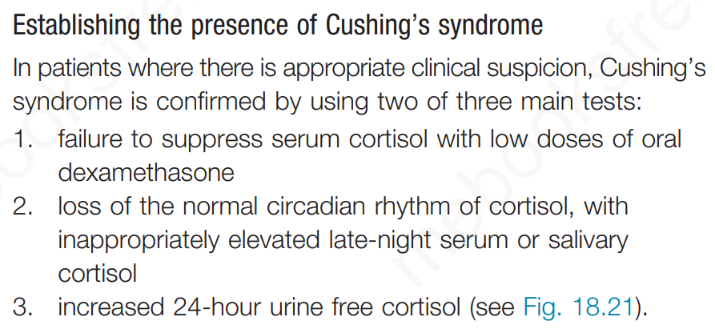

Slide 7
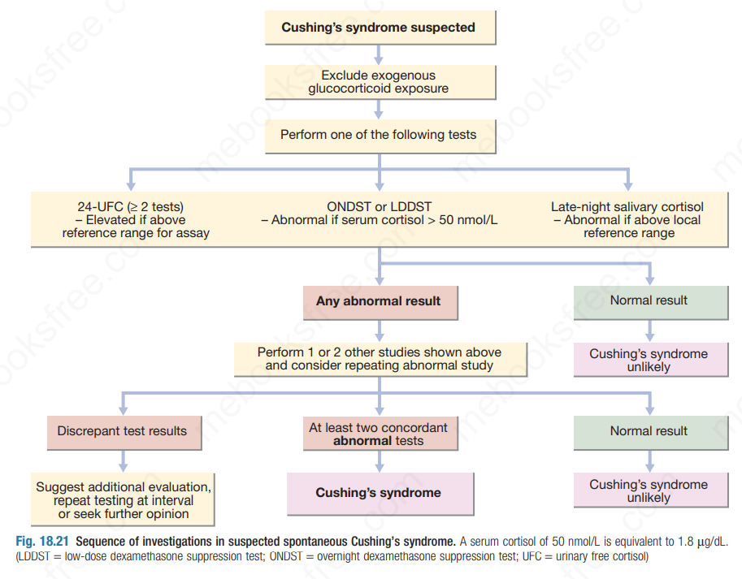

Slide 8
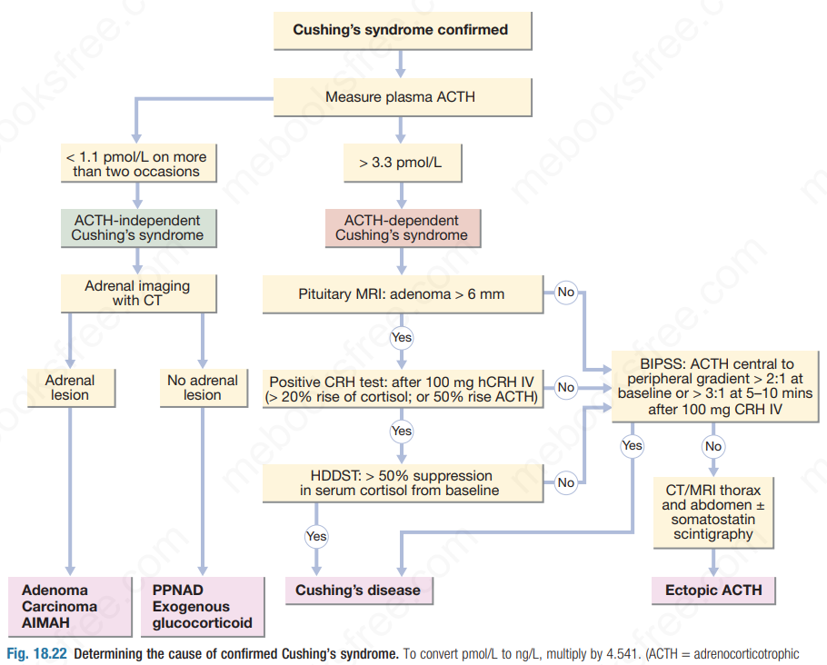

Slide 9
Management
Untreated severe Cushing’s syndrome has a 50% 5-year mortality
Most patients are treated surgically
Medical therapy may be given in severe cases for a few weeks prior to operation to improve the clinical state
A number of drugs are available that inhibit glucocorticoid biosynthesis, including metyrapone and ketoconazole
The dose of these agents is best titrated against serum cortisol levels or 24-hour urine free cortisol

Slide 10


