Slide 1
Chronic Obstructive Pulmonary Disease
Dr. Md. Monir Hosssain
Associate Professor
Department of Medicine
Shahabuddin Medical Colllege Hospital

Slide 2
Definition
Chronic obstructive pulmonary disease (COPD) is defined as a preventable and treatable disease characterized by persistent airflow limitation that is usually progressive and associated with an enhanced chronic inflammatory response in the airways and the lung to noxious particles or gases.

Slide 3
Types
Chronic bronchitis
Emphysema

Slide 4
Chronic bronchitis (cough and sputum for at least 3 consecutive months in each of 2 consecutive years)
Emphysema (abnormal permanent enlargement of the airspaces distal to the terminal bronchioles, accompanied by destruction of their walls and without obvious
fibrosis)

Slide 5
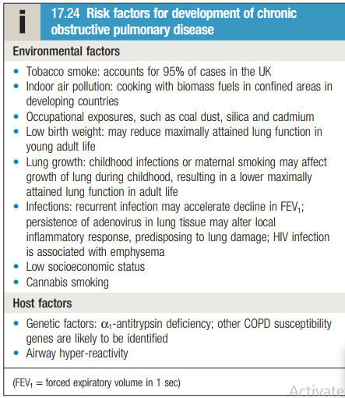

Slide 6
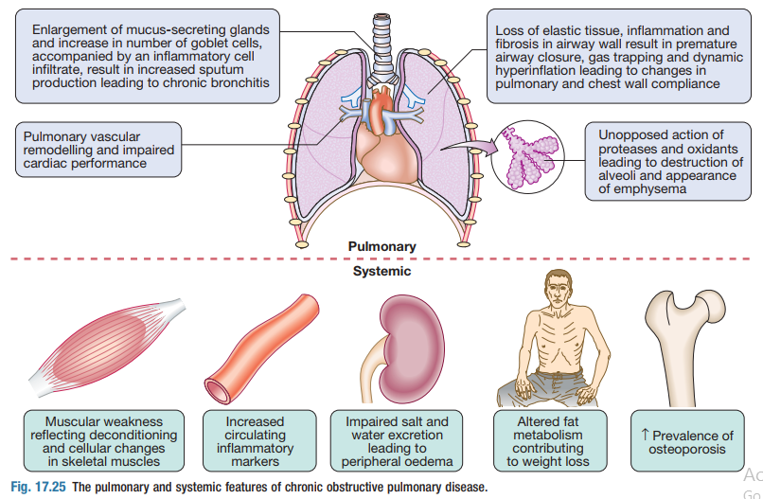
Pathophysiology

Slide 7
Symptoms
Cough and associated sputum production are usually the first symptoms, and are often referred to as a ‘smoker’s cough’
Haemoptysis
Breathlessness
Morning headaches (which may suggest hypercapnia)
Fatigue
Anorexia
Weight loss

Slide 8
Physical signs
Breath sounds are typically diminished vesicular with prolonged expiration
Crackles may accompany infection
Finger clubbing is not a feature of COPD and should trigger further investigation for lung cancer or fibrosis
Right heart failure may develop in patients with advanced COPD, particularly if there is coexisting sleep apnoea or thromboembolic
disease (‘cor pulmonale’)
Depression and anxiety are also common and contribute to morbidity

Slide 9
Two classical phenotypes have been described:
‘Pink puffers’ typically thin and breathless, and maintain a normal PaCO2 until the late stage of disease
Blue bloaters’ develop (or tolerate) hypercapnia earlier and may develop oedema and secondary polycythaemia

Slide 10
Investigations
A chest X-ray is essential to identify alternative diagnoses such as cardiac failure, other complications of smoking such as lung cancer, and the presence of bullae
A blood count is useful to exclude anaemia or polycythaemia
In younger patients with predominantly basal emphysema α1 antitrypsin should be assayed
Spirometry is required to diagnose and is established when the post bronchodilator FEV1/FVC is <70% (Fixed airway obstruction)
Sputum Culture

Slide 11
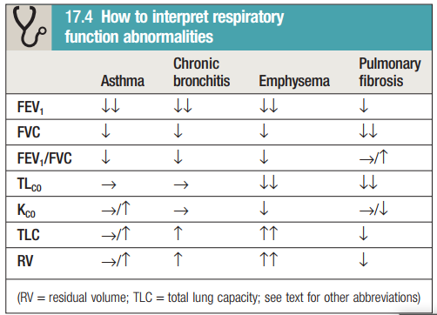

Slide 12
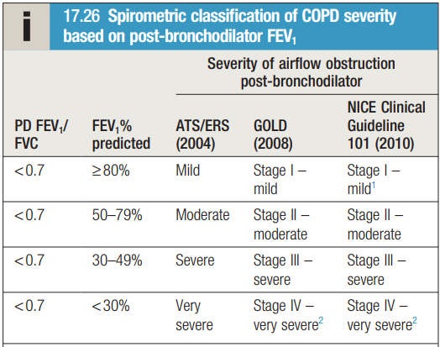

Slide 13
Management of COPD
Reducing exposure to noxious particles and gases
Bronchodilators
Combined inhaled glucocorticoids and bronchodilators
Oral glucocorticoids
Pulmonary rehabilitation
Oxygen therapy
Surgical intervention; bullectomy and lung volume reduction surgery (LVRS)
Patients with COPD should be offered an annual influenza and pneumococcal vaccination
Obesity, poor nutrition, depression and social isolation should
be identified and, if possible, improved
Mucolytic agents are occasionally used

Slide 14
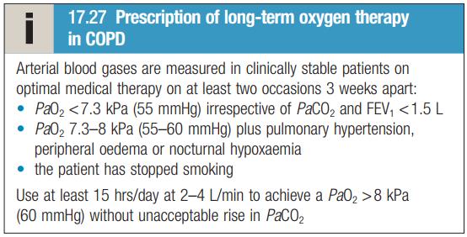

Slide 15
Management of acute exacerbations of COPD
Oxygen therapy
Bronchodilators
Glucocorticoids
Antibiotic therapy
Non-invasive ventilation (BIPAP)
If fails, mechanical ventilation

Slide 16


