Slide 1
Asthma
Dr. Md. Monir Hosssain
Associate Professor
Department of Medicine
Shahabuddin Medical Colllege Hospital

Slide 2
Asthma
Asthma is a chronic inflammatory disorder of the airways, in which many cells and cellular elements play a role
Chronic inflammation is associated with airway hyper-responsiveness that leads to recurrent episodes of wheezing, breathlessness, chest tightness and coughing, particularly at night and in the early morning

Slide 3
Pathophysiology..
Airway Hyper-Reactivity (AHR) – the tendency for airways to narrow excessively in response to triggers
The relationship between atopy (the propensity to produce IgE) and asthma is well established
In many individuals there is a clear relationship between sensitization and allergen exposure, as demonstrated by skin-prick reactivity or elevated serum-specific IgE
Common examples of allergens include house dust mites, pets such as cats and dogs, pests such as cockroaches, and fungi
Inhalation of an allergen into the airway is followed by an early and late phase bronchoconstriction

Slide 4
Pathophysiology
In cases of Aspirin-sensitive asthma, the ingestion of
salicylates results in inhibition of the cyclo-oxygenase enzymes,
resultant production of the asthmogenic cysteinyl leukotrienes
In Exercise-induced asthma, hyperventilation results in water loss from the pericellular lining fluid of the respiratory mucosa, which, in turn, triggers mediator release

Slide 5
Clinical Features
Typical symptoms include recurrent episodes of
Wheezing
Chest tightness
Breathlessness
Cough

Slide 6
Classical precipitants include exercise, particularly
in cold weather, exposure to airborne allergens or pollutants,
and viral upper respiratory tract infections
Patients with mild intermittent asthma are usually asymptomatic
between exacerbations
Individuals with persistent asthma report ongoing breathlessness and wheeze but these are variable, with symptoms fluctuating over the course of one day, or from day to day or month to month

Slide 7
Asthma characteristically displays a diurnal pattern, with symptoms and lung function being worse in the early morning
Cough may be the dominant symptom in some patients, and the lack of wheeze or breathlessness may lead to a delay in reaching the diagnosis of so-called ‘cough-variant asthma’
In some circumstances, the appearance of asthma is triggered by medications. Beta-blockers, even when administered topically as eye drops, may induce bronchospasm, as may aspirin and other non-steroidal anti-inflammatory drugs (NSAIDs)

Slide 8
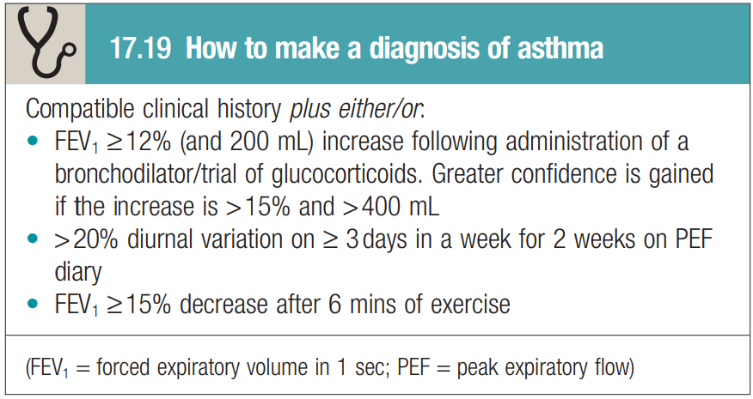

Slide 9
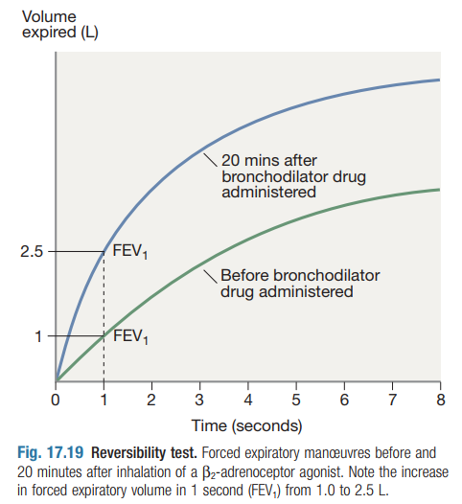

Slide 10
The diagnosis may be supported by the presence of atopy
demonstrated by
skin-prick tests
Measurement of total and allergen-specific IgE
FENO of ≥40 parts per billion in a glucocorticoid-naïve adult
Peripheral blood eosinophilia
Chest X-ray appearances are often normal

Slide 11
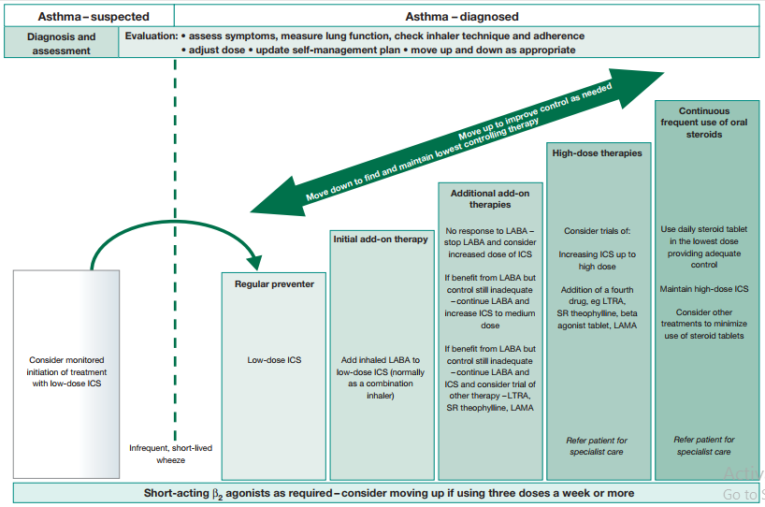

Slide 12
Stepwise approach to the management of asthma
Step 1: Occasional use of inhaled short-acting β2-adrenoreceptor agonist (SABA) bronchodilators such as salbutamol or terbutaline
Step 2:
Introduction of regular preventer anti-inflammatory therapy preferably inhaled glucocorticoids (ICS)
Such as beclometasone, budesonide, fluticasone, mometasone or ciclesonide should be started in addition to inhaled β2-agonists
For adults, a reasonable starting dose is 400 μg beclometasone
dipropionate (BDP) or equivalent per day in adults

Slide 13
Step 3: Add-on therapy
A further increase in the dose of inhaled glucocorticoid may benefit
The addition of a long-acting β2-agonist (LABA) to an inhaled glucocorticoid provides more effective asthma control compared with increasing the dose of inhaled glucocorticoid alone
Fixed combination inhalers of glucocorticoids and LABAs have been developed; these are more convenient
Step 4: Addition of a fourth drug
In adults, the dose of inhaled glucocorticoid may be increased to 2000 μg BDP/BUD (or equivalent) daily
Leukotriene receptor antagonists, long-acting anti-muscarinic agents, theophyllines or a slow-release β2-agonist may be considered
If the trial of add-on therapy is ineffective, it should be discontinued

Slide 14
Step 5: Continuous or frequent use of oral glucocorticoids
At this stage, prednisolone therapy (usually administered as a single daily dose in the morning) should be prescribed in the lowest amount necessary to control symptoms
Omalizumab (a monoclonal antibody directed against IgE)
In patients who continue to experience symptoms and asthma exacerbation and demonstrate impaired lung function despite step 5 treatment
Mepolizumab (a monoclonal antibody that blocks the binding of IL-5 to its receptor on eosinophils)
should be considered in those with eosinophilic-mediated disease

Slide 15
Step-down therapy
Once asthma control is established, the dose of inhaled (or oral) glucocorticoid should be titrated to the lowest dose at which effective control of asthma is maintained
Decreasing the dose of glucocorticoid by around 25–50% every 3 months is a reasonable strategy for most patients

Slide 16
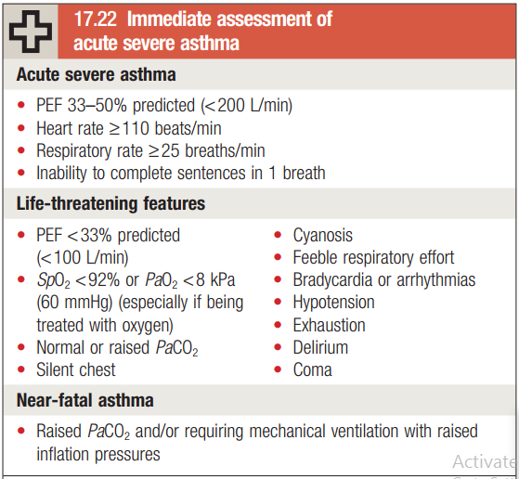

Slide 17
Management of Acute Severe Asthma
The immediate assessment requirements in acute asthma
Measurement of PEF is mandatory, unless the patient is too ill to cooperate
Arterial blood gas analysis is essential to determine the PaCO2, a normal or elevated level being particularly dangerous
High concentrations Oxygen should be administered to maintain the oxygen saturation above 92% in adults
High doses of inhaled bronchodilators as short-acting β2-agonists are the agent of choice most conveniently given via a nebuliser
Ipratropium bromide provides further bronchodilator therapy and should be added to salbutamol in acute severe or life-threatening attacks
Systemic glucocorticoids reduce the inflammatory response and hasten the resolution of an exacerbation

Slide 18
If patients fail to improve, a number of further options may be considered
Intravenous magnesium may provide additional bronchodilatation in patients whose presenting PEF is below 30% predicted.
Intravenous aminophylline may be given but cardiac monitoring is recommended.
PEF should be recorded every 15–30 minutes and then every
4–6 hours
Pulse oximetry should ensure that SaO2 remains above 92%,
If PaCO2 raised, the PaO2 was below 8 kPa (60 mmHg) or the patient deteriorates endotracheal intubation and intermittent positive pressure ventilation (IPPV) should be considered

Slide 19
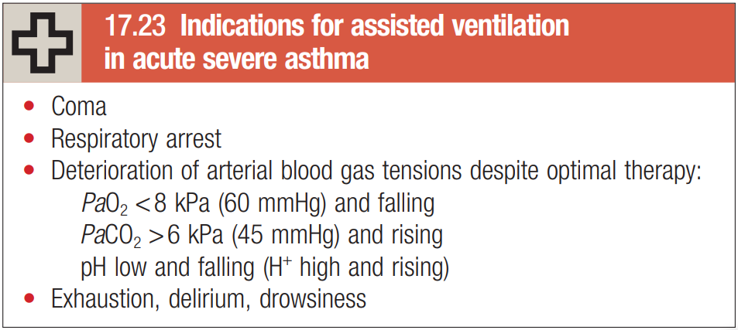

Slide 20
Discharge
Prior to discharge, patients should be stable on discharge medication (nebulised therapy should have been discontinued for at least 24 hours)
The PEF should have reached 75% of predicted or personal best

Slide 21
Advice:
Avoidance of aggravating factors
Removing or reducing exposure to relevant antigens, such as apet, may effect improvement
House dust mite exposure may be minimized by replacing carpets with floorboards and using mite impermeable bedding
Measures to reduce fungal exposure
Smoking cessation is particularly important

Slide 22


