Slide 1
Carcinoma of Lung
Dr. Md. Monir Hosssain
Associate Professor
Department of Medicine
Shahabuddin Medical Colllege Hospital

Slide 2
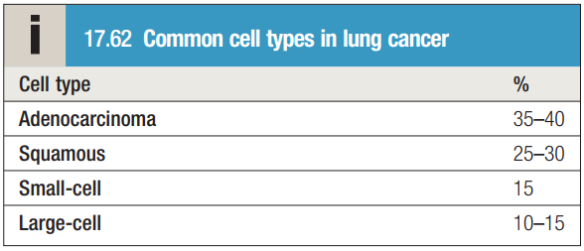

Slide 3
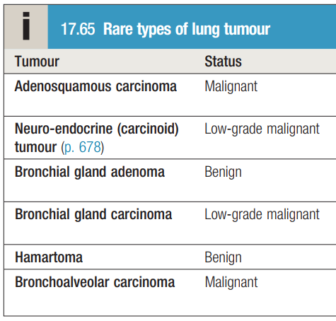

Slide 4
Aetiology
Cigarette smoking is by far the most important cause of lung cancer and it is directly responsible for at least 90% of cases
Passive smoking is responsible for 5% of all lung cancer deaths

Slide 5
Occupational lung cancer
Increased risks of lung cancer have also been reported in workers who those exposed to
Radon gas
Beryllium
diesel exhaust fumes
Cadmium
Chromium
Dust and fumes from coke plants

Slide 6
Clinical Features
Cough
Haemoptysis
Breathlessness
Finger clubbing
Pain and nerve entrapment
Mediastinal spread
Metastatic spread Bronchial obstruction
Hypertrophic pulmonary osteoarthropathy (HPOA)
Non-metastatic extrapulmonary effects

Slide 7
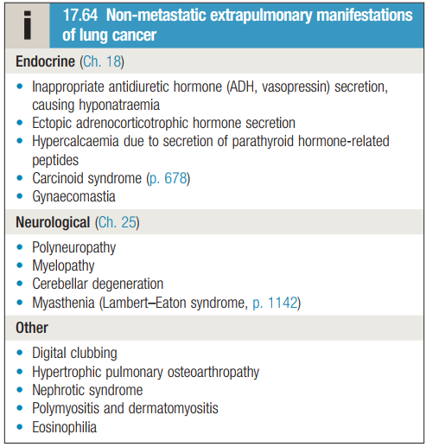
Paraneoplastic Syndrome

Slide 8
Investigations
Chest X-ray
CT scan to reveal mediastinal or metastatic spread
Bronchoscopy
Percutaneous CT-guided biopsy
Histopathology

Slide 9
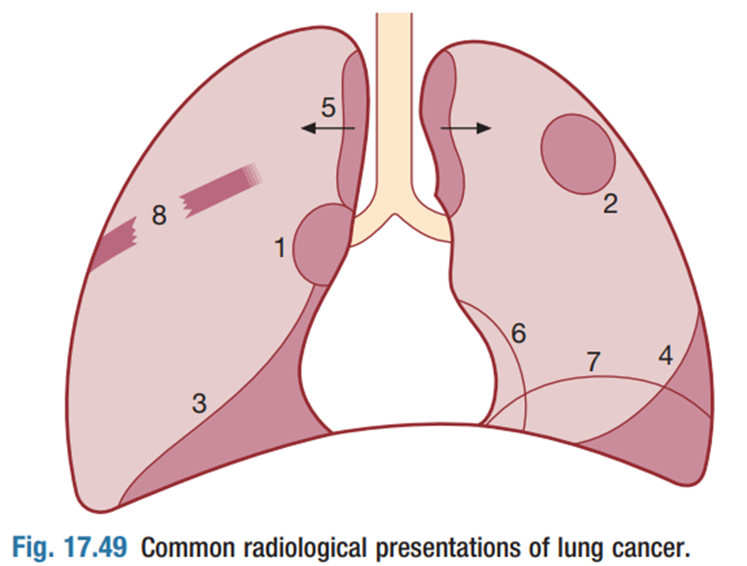
(1) Unilateral hilar enlargement (2) Peripheral pulmonary opacity
(3) Lung, lobe or segmental collapse (4) Pleural effusion
(5) Para tracheal lymphadenopathy (6) A malignant pericardial effusion
(7) A raised hemidiaphragm (8) Osteolytic rib destruction

Slide 10
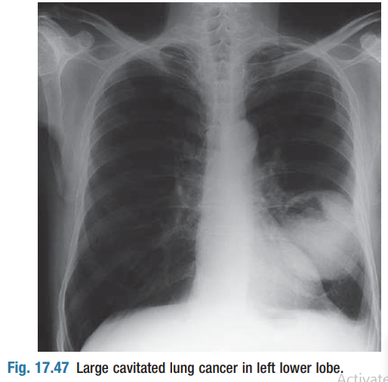

Slide 11
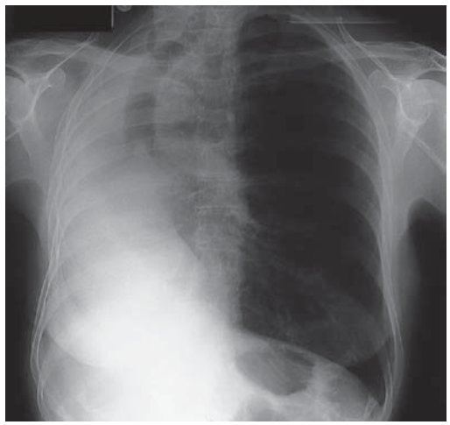

Slide 12
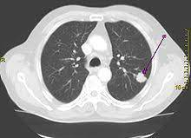

Slide 13
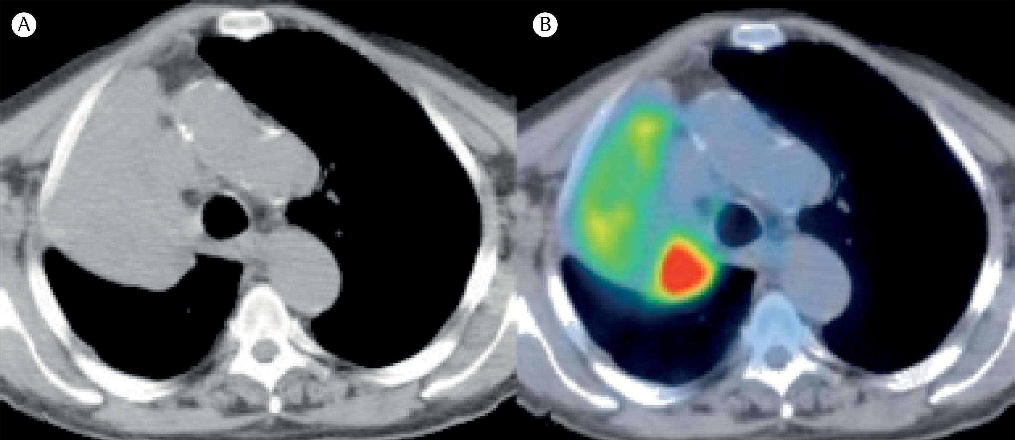

Slide 14
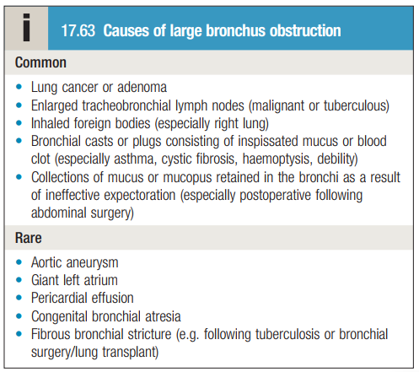

Slide 15
Management
Surgery
Radiotherapy
Chemotherapy
Laser therapy
Stenting

Slide 16
Prognosis
The overall prognosis in lung cancer is very poor, 70% of patients dying within a year of diagnosis and only 6–8% surviving 5 years after diagnosis
The best prognosis is with well-differentiated squamous cell tumours that have not metastasized and are amenable to surgical resection

Slide 17


