Slide 1
Pleural Effusion
Dr. Md. Monir Hossain
Associate Professor
Dept. of Medicine
Shahabuddin Medical College Hospital

Slide 2
Definition
Pleural extrapulmonary TB may occur early after primary infection with MTB and manifest as pleurisy with effusion.

Slide 3
Collection of fluid abnormally present in the pleural space, usually resulting from excess fluid production and/or decreased lymphatic absorption.

Slide 4
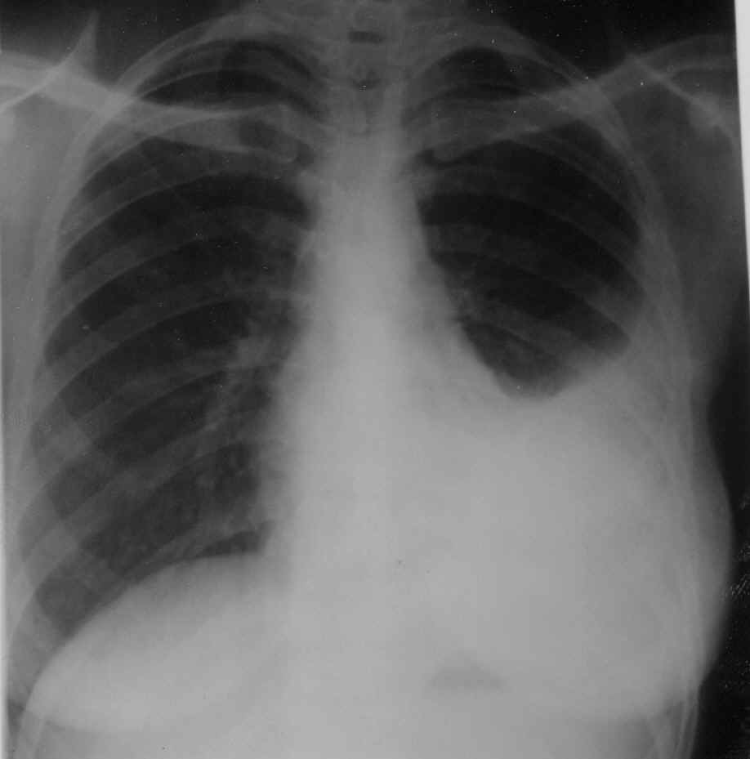

Slide 5
It is the most common manifestation of pleural disease, It may occur late in postprimary cavitary disease.
Approximately 1.5 million pleural effusion are diagnosed in the United States each year

Slide 6
Pathophysiology
Altered permeability of the pleural membranes
Reduction in intravascular oncotic pressure
Increased capillary permeability or vascular disruption
Increased capillary hydrostatic pressure in the systemic and/or pulmonary circulation

Slide 7
Types
Exudative
Transudative

Slide 8
Exudative PE
Malignancy
Pneumonia
Tuberculosis
Pulmonary embolism
Pancreatic pseudocyst
Intra-abdominal abscess
Pericardial disease
Rheumatoid pleuritis

Slide 9
Transudative PE
Congestive heart failure (most common)
Cirrhosis of LIver
Nephrotic syndrome
Hypoproteinemia

Slide 10
Clinical Features
progressive dyspnea
cough
pleuritic chest pain.

Slide 11
Investigations
Chest X ray
Computed tomography (CT) scan of the chest
Ultrasound of the chest
Thoracentesis (a needle is inserted between the ribs to remove a biopsy, or sample of fluid)
Pleural fluid analysis

Slide 12
Pleural fluid analysis
Confirmed by microscopic and chemical examination of pleural fluid.
White blood cell counts usually range from 500 to 2500 cells/mL.
The fluid is an exudate with protein usually exceeding 50% of the serum protein,
Glucose may be normal to low. Because there are few bacilli
AFB smears rarely are positive, and cultures grow MTB for only 25 to 30% of patients.

Slide 13
Pleural biopsy can confirm the diagnosis about 80% cases.

Slide 14
Treatment
According to the cause.

Slide 15
Complications
Lung scarring
Pleural thickening
Pneumothorax (collapse of the lung) as a complication of thoracentesis
Empyema (a collection of pus within the pleural space)
Sepsis (blood infection) sometimes leading to death

Slide 16
Pleurisy
Pleurisy is a condition in which the pleura two large, thin layers of tissue that separate your lungs from your chest wall becomes inflamed.

Slide 17
Symptoms
Chest pain that worsens when you breathe, cough or sneeze
Shortness of breath
Cough
Fever

Slide 18
Causes
Viral infection, such as the flu (influenza)
Bacterial infection, such as pneumonia
Fungal infection
Autoimmune disorder, such as rheumatoid arthritis or lupus
Lung cancer near the pleural surface
Pulmonary embolism
Tuberculosis (TB)
Rib fracture or trauma

Slide 19
Investigations
CBC
Chest X ray
Computed tomography (CT) scan of the chest
Ultrasound of the chest
ECG
Thoracentesis

Slide 20
Treatment
Treatment of underlying cause

