Slide 1
Respiratory Failure
Dr. Md. Monir Hosssain
Associate Professor
Department of Medicine
Shahabuddin Medical Colllege Hospital

Slide 2
The term ‘Respiratory Failure’ is used when pulmonary gas exchange fails to maintain normal arterial oxygen and carbon dioxide levels.

Slide 3
Types
Respiratory Failure is classified into types I and II based on the absence or presence of hypercapnia (raised PaCO2)
Type I respiratory failure: Arterial hypoxia with normocapnia
Type II respiratory failure: Arterial hypoxia with hypercapnia

Slide 4
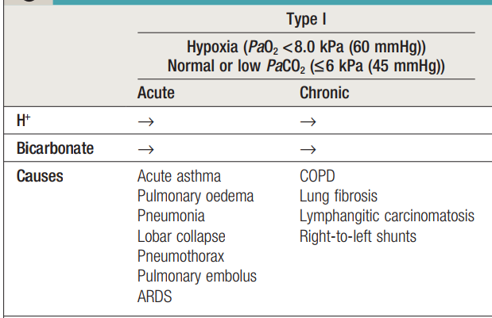

Slide 5
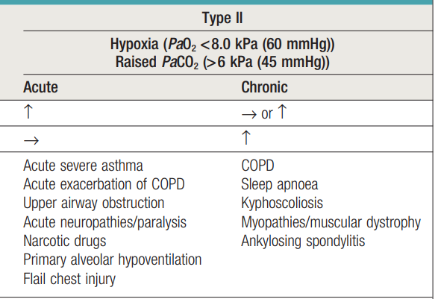

Slide 6
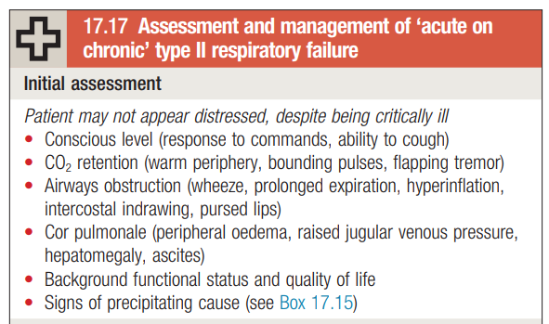

Slide 7
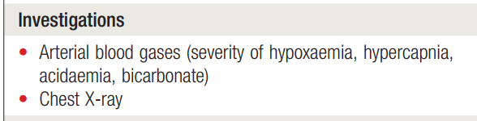

Slide 8
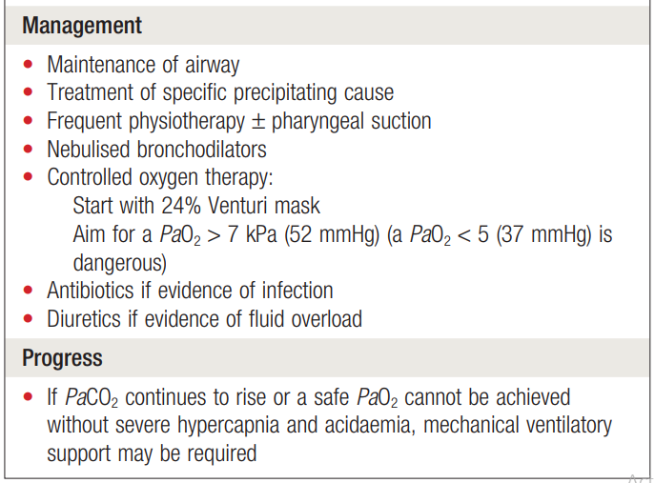

Slide 9
Cor Pulmonale
Cor pulmonale is defined as an alteration in the structure and function of the right ventricle (RV) of the heart caused by a primary disorder of the respiratory system. Pulmonary hypertension is often the common link between lung dysfunction and the heart in cor pulmonale.

Slide 10
Symptoms
Fatigue
Tachypnea
Exertional dyspnea,
Cough.

Slide 11
Signs
Pulmonary hypertension
Right ventricular hypertrophy (RVH)
RV failure
Distended neck veins with prominent a or v waves, and cyanosis may be seen.

Slide 12
On auscultation of the lungs, wheezes and crackles may be heard as signs of underlying lung disease.
Splitting of the second heart sound with accentuation of the pulmonic component can be heard in the early stages.

Slide 13
RVH is characterized by a left parasternal or subxiphoid heave. Hepatojugular reflux and pulsatile liver are signs of RV failure with systemic venous congestion.
severe disease, ascites can also be present.
Examination of the lower extremities reveals evidence of pitting edema. Edema in cor pulmonale is strongly associated with hypercapnia.

Slide 14
Hematocrit for polycythemia, which can be a consequence of underlying lung disease but can also increase pulmonary arterial pressure by increasing viscosity
Serum alpha1-antitrypsin, if deficiency is suspected
Antinuclear antibody (ANA) level for collagen vascular disease, and anti-SCL-70 antibodies in scleroderma
Coagulations studies to evaluate hypercoagulability states (eg, serum levels of proteins S and C, antithrombin III, factor V Leyden, anticardiolipin antibodies, homocysteine)

Slide 15
Management
Diuretic agents
Vasodialator
Beta-selective agonist drugs
Endothelin receptor antagonists
Phosphodiesterase type 5 (PDE5) inhibitors
Thrombolytics

Slide 16


