Slide 1
Systemic Lupus Erythematosus
&
Gout
Dr. Md. Monir Hosssain
Associate Professor
Department of Medicine
Shahabuddin Medical Colllege Hospital

Slide 2
Systemic Lupus Erythematosus
Systemic lupus erythematosus (SLE, ‘lupus’) is a rare disease with a prevalence that ranges from about 0.03% in Caucasians to 0.2% in Afro Caribbeans
90% of affected patients are female and the peak age at onset is between 20 and 30 years
There is a higher concordance in monozygotic twins and the disease is strongly associated with polymorphic variants at the HLA locus
Autoantibody production and immune complex formation are thought to be important mechanisms of tissue damage in active SLE, leading to vasculitis and organ damage

Slide 3
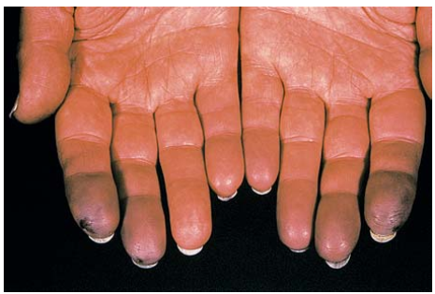
Clinical Features
Fever, fatigue, weight loss and mild lymphadenopathy
Arthritis
Raynaud’s phenomenon

Slide 4
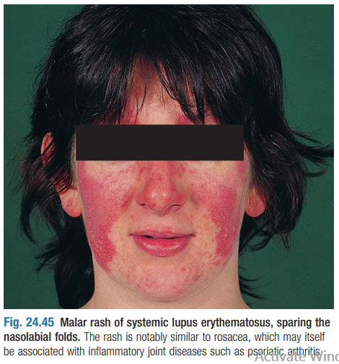
Skin
The skin is commonly involved in SLE, and many SLE skin eruptions are precipitated by exposure to ultraviolet light
The classic facial rash (up to 20% of patients)- erythematous, raised and painful or itchy, and occurs over the cheeks with sparing of the naso-labial folds
Discoid rash
Diffuse, usually non-scarring alopecia
Urticarial eruptions
Livedo reticularis

Slide 5
Kidney
Heavy haematuria, proteinuria and casts on urine microscopy
Cardiovascular
Pericarditis
Risk of atherosclerosis is greatly increased, as is the risk of stroke and myocardial infarction
Lung
Pleural effusion
Neurological
Cerebral lupus- visual hallucinations, chorea, organic psychosis, transverse myelitis and lymphocytic meningitis
Haematological
Neutropenia, lymphopenia, thrombocytopenia and haemolytic anaemia

Slide 6
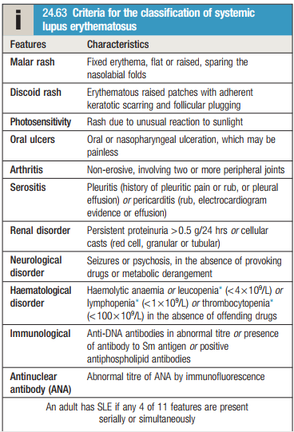

Slide 7
Management
Mild to moderate disease
NSAIDs
Hydroxychloroquine
Immunosuppressants
      Glucocorticoids
      Methotrexate
      Azathioprine
      Mycophenolate Mofetil (MMF)

Slide 8
Severe and life-threatening disease
High-dose glucocorticoids and immunosuppressants are required for the treatment of renal, CNS and cardiac involvement.
A commonly used regimen is pulsed methylprednisolone (10 mg/kg IV) plus cyclophosphamide (15 mg/kg IV), repeated at 2–3-weekly intervals for six cycles

Slide 9
Gout
Gout is the most common inflammatory arthritis in men and in older women
It is caused by deposition of monosodium urate monohydrate crystals in and around synovial joints
5 : 1 male preponderance
Gout has become progressively more common over recent years in due to the increased prevalence of obesity and metabolic syndrome

Slide 10
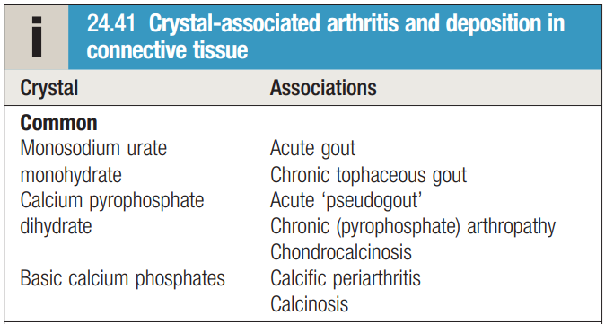

Slide 11
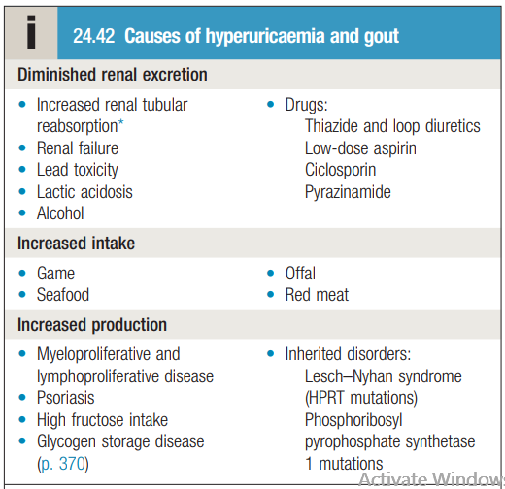

Slide 12
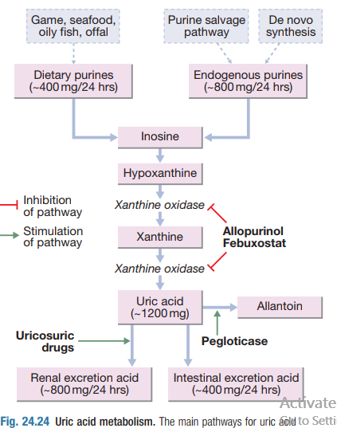

Slide 13
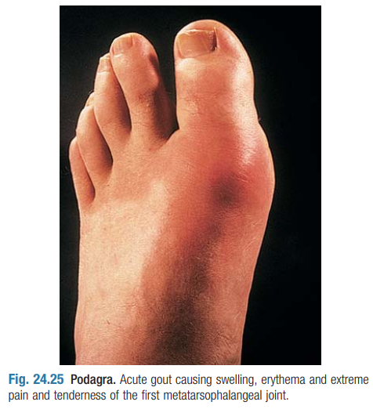
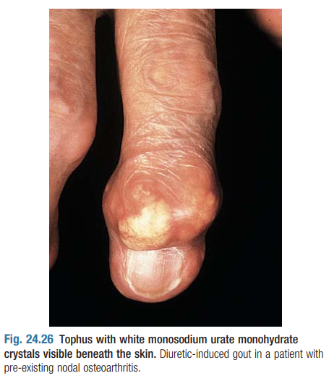
Clinical Features
The classical presentation is with an acute monoarthritis, which affects the first MTP joint in over 50% of cases
Other common sites are the ankle, midfoot, knee, small joints of hands, wrist and elbow

Slide 14
Clinical Features
rapid onset, reaching maximum severity in 2–6 hours, and often waking the patient in the early morning
severe pain, often described as the ‘worst pain ever’
extreme tenderness, such that the patient is unable to wear a sock or to let bedding rest on the joint
marked swelling with overlying red, shiny skin
self-limiting over 5–14 days, with complete resolution

Slide 15
Investigations
The diagnosis of gout can be confirmed by the identification of urate crystals in the aspirate from a joint, bursa or tophus
X-ray of joint

Slide 16
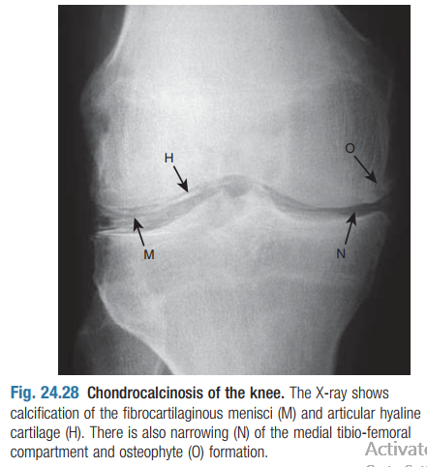
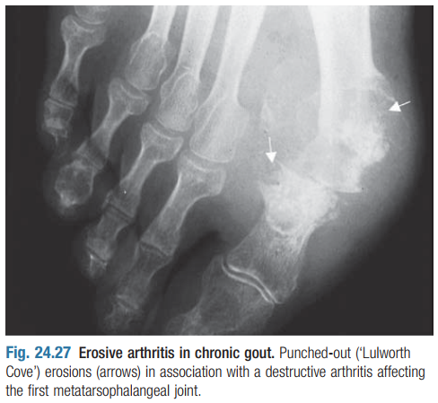

Slide 17
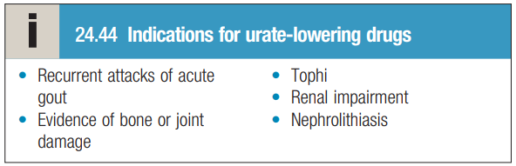
Management
Acute gout
Oral colchicine given in doses of 0.5 mg twice or 3 times daily is the treatment of first choice in acute gout
Oral NSAIDs
Oral prednisolone
Joint aspiration can give pain relief, particularly if a large joint is affected, and may be combined with an intra-articular glucocorticoid injection
Prophylaxis
Urate-lowering therapy- Allopurinol is the drug of first choice

Slide 18


