Slide 1
Diabetes Mellitus
Dr. Monir Hossain
Associate Professor
Department of Medicine
Shahabuddin Medical College Hospital

Slide 2
Epidemiology
The incidence of diabetes is rising worldwide
Globally, it is estimated that 415 million people had diabetes in 2015 (10% of the world adult population)
But it is expected to reach 642 million by 2040

Slide 3
Prevalence of Diabetes varies considerably around the world and being associated with different factors-
    Genetic factors
    Environmental factors such as greater longevity, obesity, unsatisfactory diet, sedentary lifestyle, increasing urbanization and economic development

Slide 4
Definition
Diabetes mellitus is a clinical syndrome characterized by an increase in plasma blood glucose (hyperglycaemia)

Slide 5
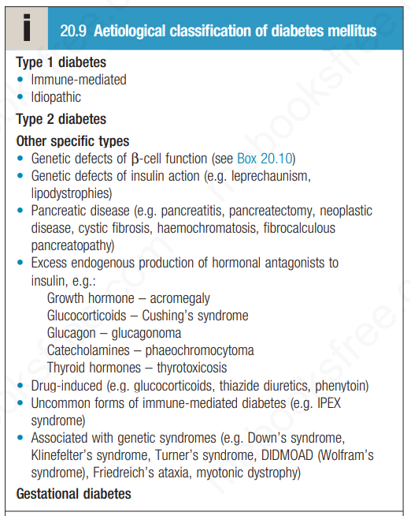

Slide 6
Pathogenesis
Type 1 diabetes is generally considered to result from autoimmune destruction of insulin-producing cells (β cells) in the pancreas, leading to marked insulin deficiency
Type 2 diabetes is characterized by reduced sensitivity to the action of insulin and an inability to produce sufficient insulin to overcome this ‘insulin resistance’

Slide 7
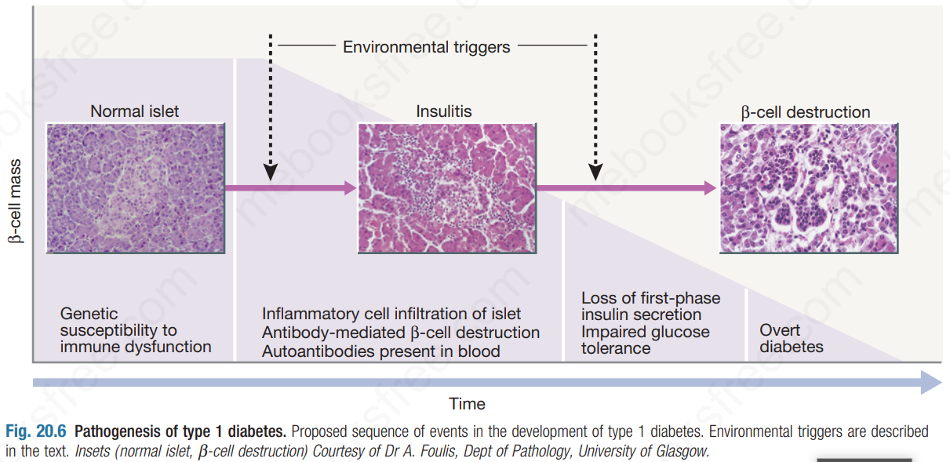

Slide 8
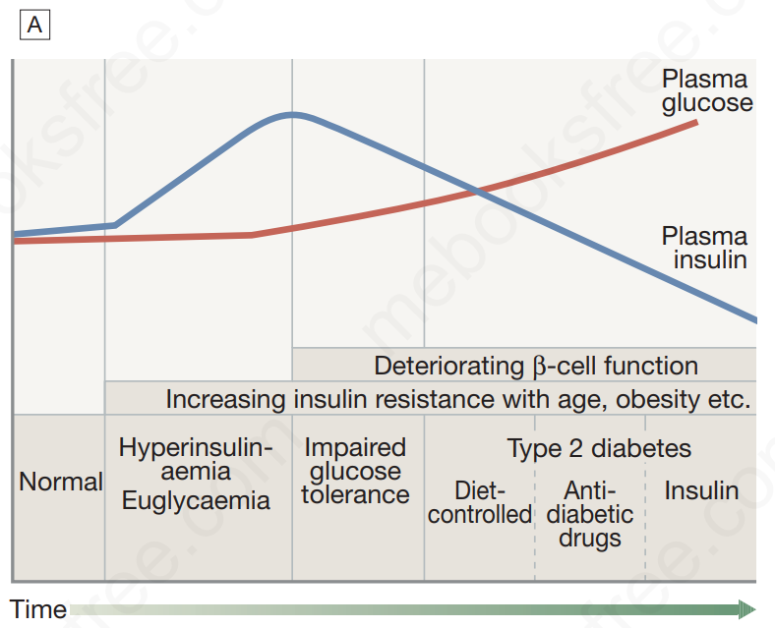
Natural History of Type 2 DM

Slide 9
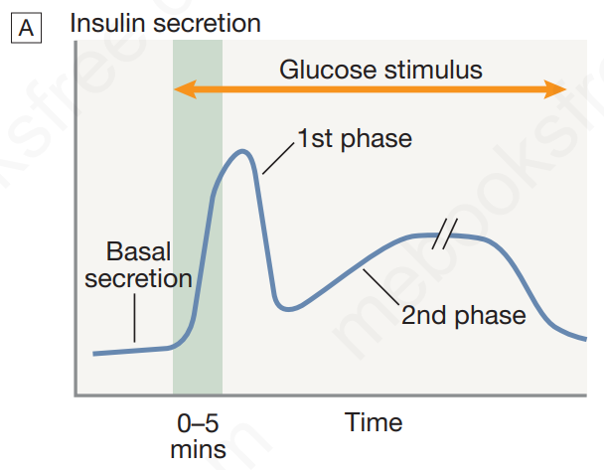
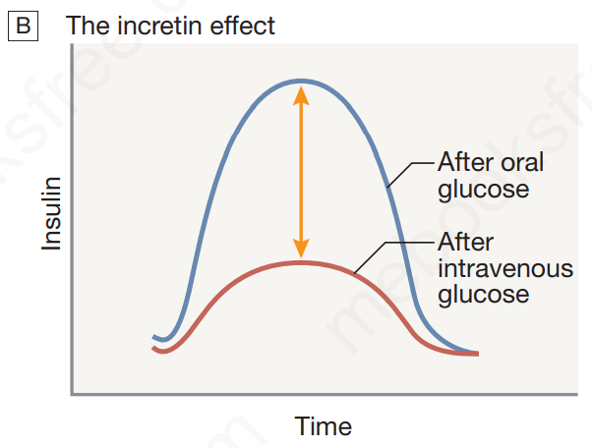
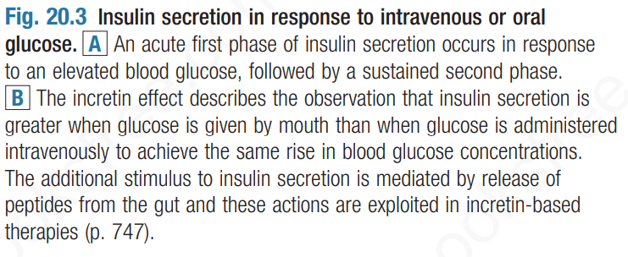

Slide 10
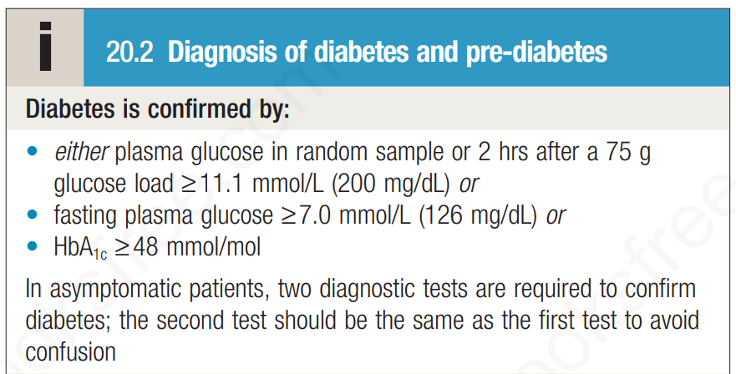

Slide 11
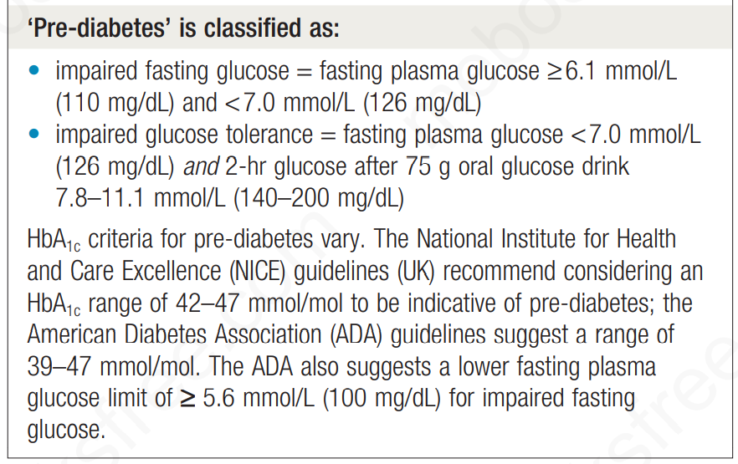

Slide 12
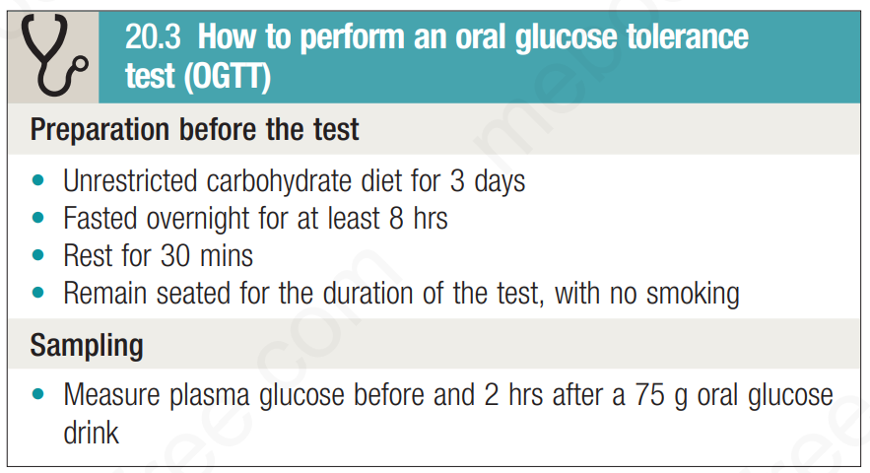

Slide 13
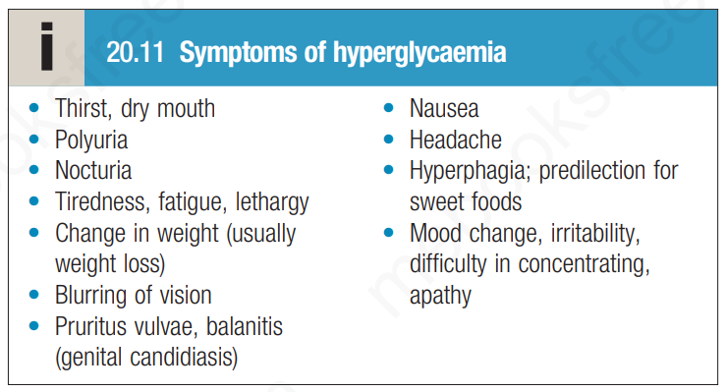

Slide 14
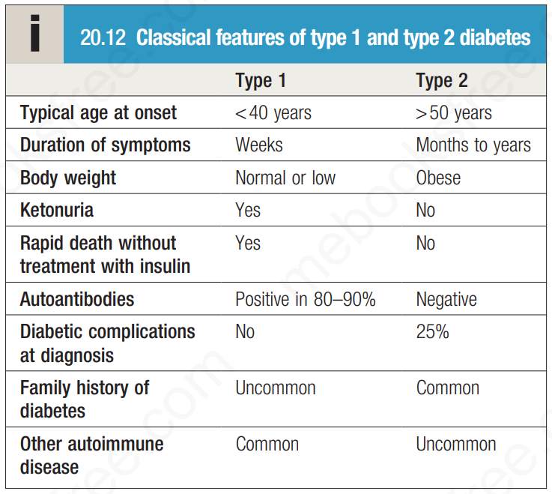

Slide 15
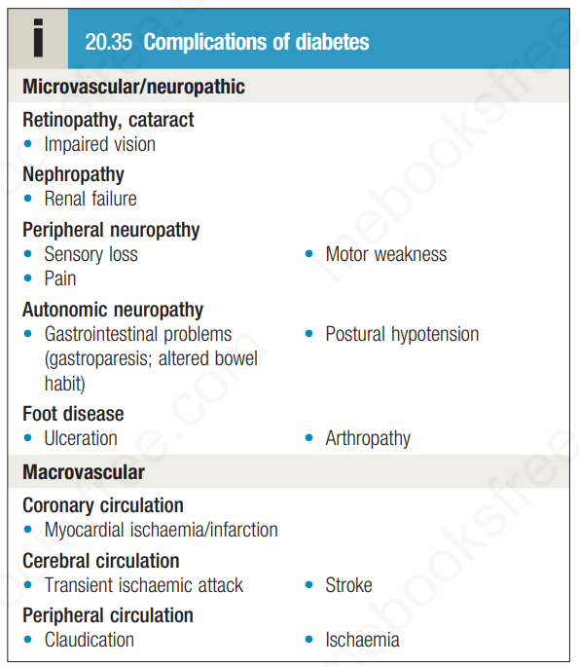

Slide 16
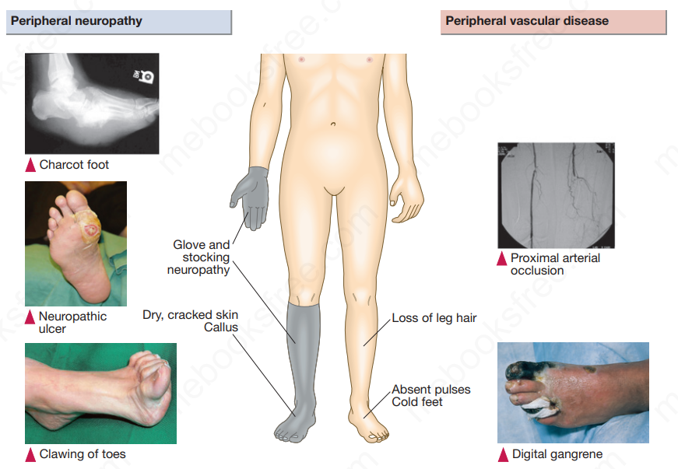

Slide 17
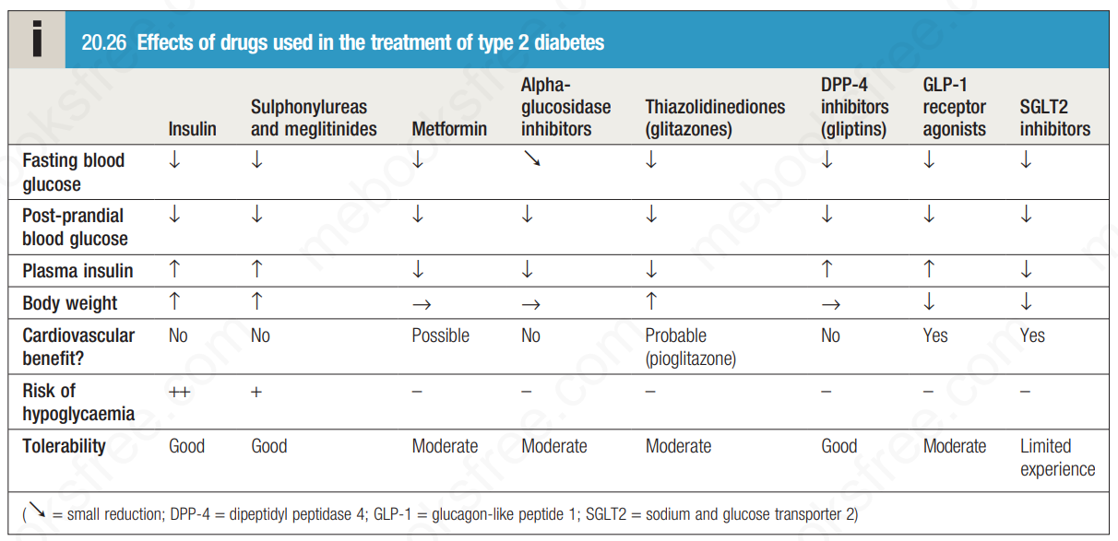

Slide 18
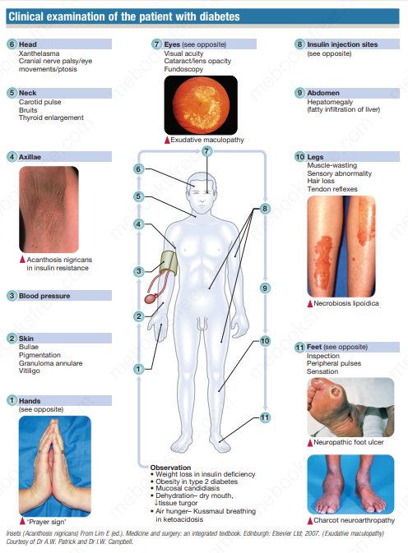

Slide 19


