Slide 2
THE UTERUS The uterus is a hollow pyriform muscular organ situated in the pelvis between the bladder in front and the rectum behind .
Position Its normal position is one of the anteversion and anteflexion.
The uterus usually inclines to the right (dextrorotation) so that the cervix is directed to the left (levorotation) and comes in close relation with the left ureter

Slide 3
Measurements and Parts
The uterus measures about 8 cm long, 5 cm wide at the fundus and its walls are about 1.25 cm thick.
Its weight varies from 50–80 g. It has got the following parts .
Body or corpus
Isthmus
Cervix

Slide 4
Body or corpus:The body is further divided into
fundus— the part which lies above the openings of the uterine tubes.
The body properly is triangular and lies between the openings of the tubes and the isthmus.
The superolateral angles of the body of the uterus project outwards from the junction of the fundus and body and are called the cornua of the uterus.
The uterine tube, round ligament, and ligament of the ovary are attached to each cornua

Slide 5
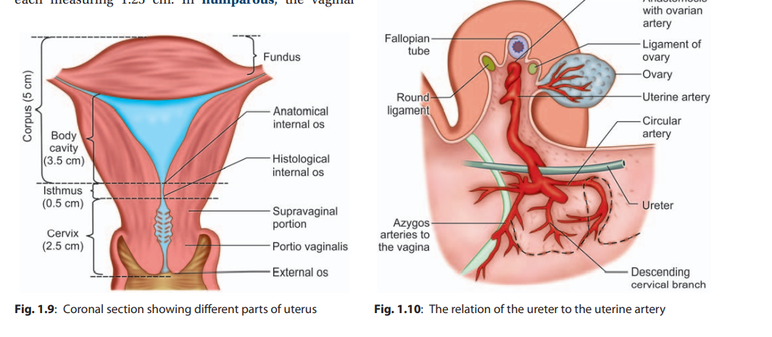

Slide 6
Isthmus: The isthmus is a constricted part measuring about 0.5 cm situated between the body and the cervix.
It is limited above by the anatomical internal os and below by the histological internal os
Cervix: The cervix is the lowermost part of the uterus.

Slide 7
It extends from the histological internal os and ends at external os which opens into the vagina after perforating the anterior vaginal wall.
It is almost cylindrical in shape and measures about 2.5 cm in length and diameter.
It is divided into a supravaginal part—the part lying above the vagina and a vaginal part which lies within the vagina, each measuring 1.25 cm.

Slide 8
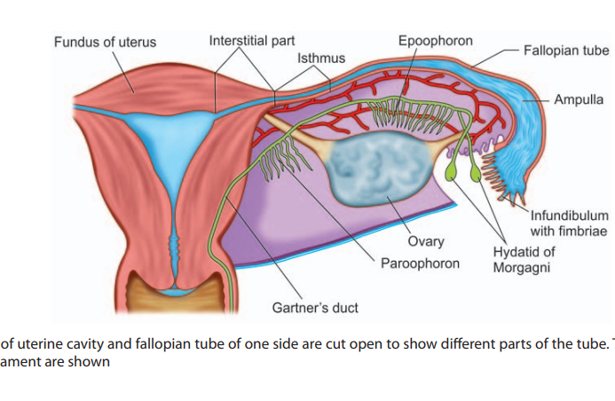

Slide 9
The cavity of the uterine body is triangular on coronal section with the base above and the apex below.
It measures about 3.5 cm. There is no cavity in the fundus.
The cervical canal is fusiform and measures about 2.5 cm. Thus, the normal length of the uterine cavity including the cervical canal is usually 6–7 cm

Slide 10
Structures
Body The wall consists of 3 layers from outside inwards:
Perimetrium: It is the serous coat which invests the entire organ except on the lateral borders. The peritoneum is intimately adherent to the underlying muscles
Myometrium: It consists of thick bundles of smooth muscle fibers held by connective tissues and are arranged in various directions

Slide 11
Endometrium: The mucous lining of the cavity is called endometrium. As there is no submucous layer, the endometrium is directly apposed to the muscle coat.
It consists of lamina propria and surface epithelium.
The surface epithelium is a single layer of ciliated columnar epithelium
The endometrium is changed to decidua during pregnancy

Slide 12
Blood Supply
Arterial supply: The arterial supply is from the uterine artery—one on each side.
The artery arises directly from the anterior division of the internal iliac or in common with superior vesical artery.
The other sources are ovarian and vaginal arteries to which the uterine arteries anastomose.
The uterine artery crosses the ureter anteriorly about 1.5 cm away at the level of internal os before it ascends up along the lateral border of the uterus in between the leaves of broad ligament.

Slide 13
Changes of Uterus with Age
At birth, the uterus lies in the false pelvis; the cervix is much longer than the body.
In childhood, the proportion is maintained but reduced to 2:1.
At puberty, the body is growing faster under the action of ovarian steroids (estrogens) and the proportion is reversed to 1:2 and
following childbirth, it becomes even 1:3.
After menopause the uterus atrophies; the overall length is reduced;

Slide 14
Position of the Uterus The normal position of the uterus is anteversion and anteflexion.
Anteversion relates the long axis of the cervix to the long axis of vagina which is about 90°.
Anteflexion relates the long axis of the body to the long axis of the cervix and is about 120°.
In about 15–20%, normally the uterus remains in retroverted position.
In erect posture, the internal os lies on the upper border of the symphysis pubis and
the external os lies at the level of ischial spine

Slide 15
FALLOPIAN TUBE (SYN: UTERINE TUBE)
The uterine tubes are paired structures, measuring about 10 cm (4") and are situated in the medial three-fourth of the upper free margin of the broad ligaments.
Each tube has got two openings, one communicating with the lateral angle of the uterine cavity, called uterine opening and measures 1 mm in diameter,
the other is on the lateral end of the tube, called pelvic opening or abdominal ostium and measures about 2 mm in diameter

Slide 16
Parts: There are four parts, from medial to lateral, they are—
(1) intramural or interstitial lying in the uterine wall and measures 1.25 cm (1/2) in length and 1 mm in diameter;
(2) isthmus almost straight and measure about 2.5 cm (1") in length and 2.5 mm in diameter;
(3) ampulla—tortuous part and measures about 5 cm (2) in length which ends in wide;
(4) infundibulum measuring about 1.25 cm (1/2) long with a maximum diameter of 6 mm

Slide 17
The abdominal ostium is surrounded by a number of radiating fimbriae, one of these is longer than the rest and is attached to the outer pole of the ovary called ovarian fimbria .
Structures—It consists of 3 layers:
1. Serous:
. 2. Muscular: Arranged in two layers—outer longitudinal and inner circular.
3. Mucous membrane is thrown into longitudinal folds

Slide 18
THE OVARY The ovaries are paired sex glands or gonads in female which are concerned with:
i. Germ cell maturation, storage and its release
ii. Steroidogenesis.
Each gland is oval in shape and pinkish gray in color and the surface is scarred during reproductive period.
It measures about 3 cm in length, 2 cm in breadth and 1 cm in width

Slide 19
. Each ovary presents two ends—tubal and uterine,
two borders—mesovarium and free posterior and
two surfaces—medial and lateral.
The ovaries are intraperitoneal structures.
In nulliparae, the ovary lies in the ovarian fossa on the lateral pelvic wall.
The ovary is attached to the posterior layer of the broad ligament by the mesovarium, to the lateral pelvic wall by infundibulopelvic ligament and to the uterus by the ovarian ligament

Slide 20
VAGINA The vagina is a fibromusculomembranous sheath communicating the uterine cavity with the exterior at the vulva.
It constitutes the excretory channel for the uterine secretion and menstrual blood.
It is the organ of copulation and forms the birth canal of parturition.
The canal is directed upwards and backwards forming an angle of 45° with the horizontal in erect posture.

Slide 21
Walls= Vagina has got an anterior, a posterior, and two lateral walls.
The anterior and posterior walls are apposed together but the lateral walls are comparatively stiffer specially at its middle, as such it looks ‘H’ shaped on transverse section.
The length of the anterior wall is about 7 cm and that of the posterior wall is about 9 cm .
The upper end of vagina is above the pelvic floor

Slide 22
Fornices
The fornices are the clefts formed at the top of vagina (vault) due to the projection of the uterine cervix through the anterior vaginal wall, where it is blended inseparably with its wall.
There are four fornices—one anterior, one posterior, and two lateral; the posterior one being deeper and the anterior, most shallow one.

Slide 23
Relations
Anterior: The upper one-third is related with base of the bladder and the lower two-thirds are with the urethra, the lower half of which is firmly embedded with its wall
Posterior: The upper one-third is related with the pouch of Douglas, the middle-third with the anterior rectal wall separated by rectovaginal septum, and the lower-third is separated from the anal canal by the perineal body .

Slide 24
Lateral walls:
The upper one-third is related with the pelvic cellular tissue at the base of broad ligament in which the ureter and the uterine artery lie approximately 2 cm from the lateral fornices.
The middle-third is blended with the levator ani and the lower-third is related with the bulbocavernosus muscles, vestibular bulbs, and Bartholin’s glands

Slide 25
Lateral walls:
The upper one-third is related with the pelvic cellular tissue at the base of broad ligament in which the ureter and the uterine artery lie approximately 2 cm from the lateral fornices.
The middle-third is blended with the levator ani and the lower-third is related with the bulbocavernosus muscles, vestibular bulbs, and Bartholin’s glands .

Slide 26
Relations of uterus
Relations
Anteriorly: Above the internal os, the body forms the posterior wall of the uterovesical pouch.
Below the internal os, it is separated from the base of the bladder by loose areolar tissue
Posteriorly: It is covered by peritoneum and forms the anterior wall of the pouch of Douglas containing coils of intestine.

Slide 27
Laterally: The double folds of peritoneum of the broad ligament are attached laterally between which the uterine artery ascends up.
Attachment of the Mackenrodt’s ligament extends from the internal os down to the supravaginal cervix and lateral vaginal wall.
About 1.5 cm away at the level of internal os, a little nearer on the left side is the crossing of the uterine artery and the ureter.
The uterine artery crosses from above and in front of the ureter, soon before the ureter enters the ureteric tunnel

Slide 28
The ovaries are intraperitoneal structures.
In nulliparae, the ovary lies in the ovarian fossa on the lateral pelvic wall.
The ovary is attached to the posterior layer of the broad ligament by the mesovarium, to the lateral pelvic wall by infundibulopelvic ligament and to the uterus by the ovarian ligament.
Relations: Mesovarium or anterior border—A fold of peritoneum from the posterior leaf of the broad ligament is attached to the anterior border through which the ovarian vessels and nerves enter the hilum of the gland.

Slide 29
Posterior border is free and is related with tubal ampulla. It is separated by the peritoneum from the ureter and the internal iliac artery.
Medial surface is related to fimbrial part of the tube.
Lateral surface is in contact with the ovarian fossa on the lateral pelvic wall.
The ovarian fossa is related superiorly to the external iliac vein, posteriorly to ureter and internal iliac vessels and laterally to the peritoneum separating the obturator vessels and nerves

