Slide 2
TEMPORARY METHODS
Temporary methods are commonly used to postpone or to space births..
BARRIER METHODS These methods prevent sperm deposition in the vagina or prevent sperm penetration through the cervical canal.
The objective is achieved by mechanical devices or by chemical means which produce sperm immobilization, or by combined means.
The following are used

Slide 3
Mechanical
Male — Condom
Female — Condom, diaphragm, cervical cap
Chemical (Vaginal contraceptives)
Creams — Delfen (nonoxynol-9, 12.5 %)
Jelly -
Foam tablets—

Slide 4
Advantage
Cheaper with no contraindications
No side effects
Protection against sexually transmitted diseases, e.g. gonorrhea, chlamydia, HPV and HIV
Protection against pelvic inflammatory diseases

Slide 5
Reduces the incidence of tubal infertility and ectopic pregnancy
Protection against cervical cell abnormality
Disadvantages
Failure rate is high (17 %)

Slide 6
FERTILITY AWARENESS METHOD.
Rhythm Method This is the only method approved by the Roman Catholic Church.
The methods to determine the approximate time of ovulation and the fertile period include—
(a) recording of previous menstrual cycles (calendar rhythm)
(b) noting the basal body temperature chart (temperature rhythm) and
(c) noting excessive mucoid vaginal discharge (mucus rhythm). The users of the calendar method obtain the period of abstinence

Slide 7
Breastfeeding, Lactational Amenorrhea (LAM) Prolonged and sustained breastfeeding offers a natural protection of pregnancy.
This is more effective in women who are amenorrheic than those who are menstruating.
The risk of pregnancy to a woman who is fully breastfeeding and amenorrheic is less than 2% in the first 6 months.
Otherwise, the failure rate is high (1–10%).

Slide 8
Thus during breastfeeding, additional contraceptive support should be given by barrier method, IUCD or injectable steroids where available to provide complete contraception.
When the women is full breastfeeding, a contraceptive method should be used in the 3rd postpartum month and with partial or no breastfeeding, she should use it in the 3rd postpartum week.
Fertility awareness based methods are: (1) Natural contraception (rhythm method, coitus interruptus, and LAM)
(2) Barrier method (condoms, diaphragm, and spermicides)

Slide 9
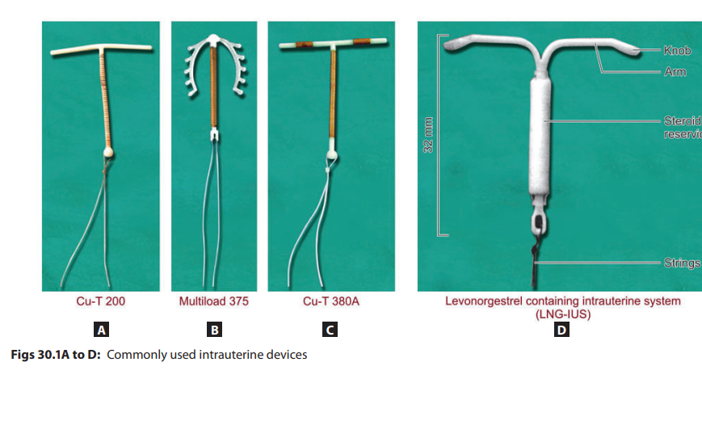

Slide 10
INTRAUTERINE CONTRACEPTIVE DEVICES (IUCDs)
The device is classified as open, -when it has got no circumscribed aperture of more than 5 mm so that a loop of intestine or omentum cannot enter and become strangulated if, accidentally, the device perforates through the uterus into the peritoneal cavity.
Lippes loop, Cu-T, Cu-7, Multiload and Progestasert are examples of open devices.
closed devices are obsolete

Slide 11
The device may be nonmedicated as Lippes loop or medicated (bioactive) by incorporating a metal copper, in devices like Cu T-200, Cu T-380A, Multiload-250, Multiload-375
. Hormone containing IUDs either releasing progesterone (progestasert) or levonorgestrel (LNG-IUS) has also been introduced.
Cu T-380 A. In spite of copper being radioopaque, additional barium sulfate is incorporated in the device. The device is replaced every 10 years.

Slide 12
Mode of action
Biochemical and histological changes in the endometrium:
There is a nonspecific inflammatory reaction along with biochemical changes in the endometrium which have got gametotoxic and spermicidal property.
Lysosomal disintegration from the macrophages attached to the device liberates prostaglandins, which are toxic to spermatozoa. Macrophages cause phagocytosis of spermatozoa.
There may be increased tubal motility which prevent fertilization of the ovum.

Slide 13
There may be increased tubal motility which prevent fertilization of the ovum.
Endometrial inflammatory response decreases sperm transport and impedes the ability of sperm to fertilize the ovum.
Copper devices: prevents blastocyst implantation through enzymatic interference.
Copper initiates the release of cytokines which are cytotoxic

Slide 14
Levonorgestrel-IUS (Mirena): It induces strong and uniform suppression of endometrium.
Cervical mucus becomes very scanty.
Anovulation and insufficient luteal phase activity .
It decreases tubal motility.

Slide 15
Contraindications for Insertion of IUCD
(1) Presence of pelvic infection current or within 3 months;
(2) Undiagnosed genital tract bleeding;
(3) Suspected pregnancy;
(4) Distortion of the shape of the uterine cavity as in fibroid or congenital uterine malformation;
(5) Severe dysmenorrhea;
(6) Past history of ectopic pregnancy; (7) Within 6 weeks following cesarean section;

Slide 16
(8) Sexually transmitted infections (STIs): Current or within 3 months; (9) Trophoblastic disease;
(10) Significant immunosuppression.
Additionally for Cu-T are: (11) Wilson disease, and (12) Copper allergy.
For LNG-IUS are: (13) Hepatic tumor or hepatocellular disease (active); (14) Current breast cancer and (15) Severe arterial disease

Slide 17
Interval (when the insertion is made in the interconceptional period beyond 6 weeks following childbirth or abortion):
It is preferable to insert 2–3 days after the period is over. But it can be inserted any time during the cycle even during menstrual phase which has certain advantages (open cervical canal, distended uterine cavity, less cramp).
However, during lactational amenorrhea, it can be inserted at any time

Slide 18
Postabortal - suction evacuation or D and E, or following spontaneous abortion, the device may be inserted. The additional advantage of preventing uterine synechia can help in motivation for insertion.
Postpartum: after 6 weeks when the uterus will be involuted to near normal size.
Postplacental delivery

Slide 19
it is done following vaginal delivery as well as following cesarean section.
Advantages are:
(a) safe and highly effective,
(b) immediate action,
(c) long term protection,
(d) special benefit to women having limited access or no access to postpartum care, and
(e) immediate return to fertility after removal. But the expulsion rate is high

Slide 20
Complications -Immediate
Cramp like pain
Syncopal attack:
Partial or complete perforation
Remote-
Pain: The pain is more or less.
Abnormal menstrual bleeding
Pelvic inflammatory disease (PID): The risk of developing PID is 2–10 times greater amongst IUD users.

Slide 21
Pain, abnormal uterine bleeding (AUB) and PID are the principal factors related to its discontinuation (10–15%)
Spontaneous expulsion
Perforation of the uterus:
Diagnosis of uterine perforation: Nonvisibility of the thread through the external os

Slide 22
Indications for Removal of IUDs
(1) Persistent excessive regular or irregular uterine bleeding,
(2) Flaring up of salpingitis,
(3) Perforation of the uterus
, (4) IUD has come out of place (partial expulsion),
(5) Pregnancy occurring with the device in situ,
(6) Woman desirous of a baby,
(7) Missing thread, (8) One year after menopause and
9)When the effective lifespan is over

Slide 23
Missing Threads The thread may not be visible through the cervical os due to—
(a) Thread coiled inside;
(b) Thread torn through;
(c) Device expelled outside unnoticed by the patient;
(d) Device perforated the uterine wall and is lying in the peritoneal cavity and
(e) Device pulled up by the growing uterus in pregnancy

Slide 24
Methods of Identification
Pregnancy is to be excluded first:
Ultrasonography can detect the IUD either within the uterine cavity or in the peritoneal cavity (if perforated). I.
Hysteroscopy can be used for direct visualization of the uterine cavity and it could be removed simultaneously
Sounding the uterine cavity by a probe
. If negative, straight X-ray after introducing radiopaque probe (uterine sound) into the uterine cavity

Slide 25
Removal
Device inside the uterine cavity:
It can be removed by any of the following methods mentioned below: Specially designed blunt hook.
Hysteroscopically under direct vision
Uterine curette
Artery forceps
. Outside the uterus but inside the abdominal cavity: (i) Laparoscopy (ii) Laparotomy

Slide 26
Noncontraceptive benefits specially with LNG-IUD:
Significant reduction in menstrual blood loss, menorrhagia, dysmenorrhea, and premenstrual tension syndrome (PMS).
It can be used in the treatment of endometrial hyperplasia, adenomyosis, endometriosis, uterine leiomyomas, and endometrial cancer.

Slide 27
It can be used as an alternative to hysterectomy for menorrhagia, dysfunctional uterine bleeding (DUB).
It provides excellent benefits of hormone replacement therapy (HRT) when used over the transition years of reproduction to perimenopause

Slide 28
n. While Cu-T 200 should be removed after 3–4 years, Multiload 375 is replaced after 5 years, Cu-T 380A after 10 years and LNG-IUS after 5 yearss

