Slide 2
Tear of the perineal body involving the sphincter ani externus with or without involvement of the anorectal mucosa is called complete perineal tear.
It is called old when passed beyond an arbitrary period of 3 months following the injury
OBSTETRIC LEGACIES LEADING TO MAJOR GYNECOLOGICAL PROBLEMS Pelvic organ prolapse
Perineal injuries including complete perineal tear
Genitourinary and rectovaginal fistula

Slide 3
Anal incontinence (AI)
Anal fissure
Tender perineal and vaginal scar
Backache
Eversion cervix with cervicitis

Slide 4
First degree Injury to perineal skin only
Second degree Injury to perineum involving perineal muscles but not the anal sphincter
Third degree Injury to perineum involving anal sphincter complex
3a: < 50% of EAS thickness torn
3b: > 50% of EAS thickness torn
3c: Both EAS and IAS torn
Fourth degree Injury to perineum involving anal sphincter complex (EAS and IAS) and anal epithelium

Slide 5
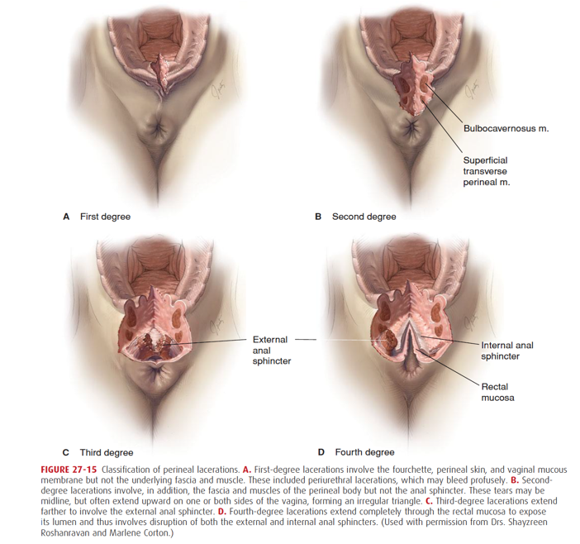

Slide 6
RISK FACTORS FOR THIRD DEGREE TEARS (RCOG–2007)
Primigravida
Big baby (> 3 kg)
Face to pubis delivery
Midline episiotomy
Forceps delivery
Outlet contraction with narrow pubic arch
Shoulder dystocia
Precipitate labor
Scar in the perineum
Prolonged second stage

Slide 7
CLINICAL FEATURES
Patient Profile Patients are usually primiparous with a history suggestive of inadequate care during childbirth.
Symptoms The chief complaints are as follows: Inability to hold the flatus and feces. While incontinence of flatus is invariable, that of feces depends on the extent of damage of the external anal sphincter
If the damage is slight, there is incontinence of only loose stool but if the damage is severe, there is incontinence of hard stool as well.

Slide 8
Soreness over the perianal region is due to constant irritation by the stool.
It is often surprising that, the condition may remain asymptomatic for many years and only discovered accidentally during pelvic examination.
Overactivity of the levator ani mused makes the patient continent with the stool

Slide 9
Signs Inspection of the perineum reveals: There is absence of perineum.
Vaginal and rectal mucous membranes are found to be continuous, only separated by a bridge of fibrous tissue (rectal mucosa is reddish and the vaginal one is pinkish in color) .

Slide 10
Visible dimple on the skin on either side of the fused mucosa may be present.
These represent the retracted torn ends of the sphincter ani externus which have got subcutaneous attachment.
Radial wrinkling of the skin is present only on the posterior aspect of the anal opening.

Slide 11
STRUCTURES TORN IN CPT
Posterior perineal skin or/and vaginal wall
Perineal muscles
Perineal body
Anal sphincter complex
Varying degrees of anorectal mucous membrane

Slide 12
Obstetrical Perineal injury (3° and 4°) results from over stretching or sudden stretching of the perineum during childbirth.
It is more common when the perineum is inelastic

Slide 13
Palpation: There is absence of the sphincteric grip evidenced when a finger is introduced into the rectum.
The anal canal is separated from the vagina only by a septum.
It is surprising that in spite of deficit of the perineum, there is no prolapse.
This is because of over-activity of the levator ani muscle. If prolapse is found along with CPT,

Slide 14
Diagnosis:
Anal imaging : Endoanal or transvaginal ultrasound (EAS or TVS) can diagnose the defect in both the internal anal sphincter (IAS) and external anal sphincter (EAS).
EAS can image the puborectalis muscle and perineal body also.
Perineal body thickness more than 12 mm gave is sufficient to maintain anal continence

Slide 15
The prevention of the perineal injuries in normal delivery includes:
More attention should be paid not to the perineum but to the controlled delivery of the head.
Delivery by early extension is to be avoided.
Flexion of the head is to be maintained till the subocciput comes under the symphysis pubis so that lesser suboccipitofrontal (10 cm) diameter emerges out of the introitus

Slide 16
Slow delivery of the head during forceps delivery maintening the correct direction of pull
To deliver the head in between contractions.
To perform timely episiotomy (when needed).
To take care during delivery of the shoulders as the wider bisacromial diameter (12 cm) emerges out .

Slide 17
The definitive surgery is repair of the anal sphincter complex (sphincteroplasty) with restoration of the perineal body (perineorrhaphy).
This should preferably be done between 2 and 3 months following the injury.
The best time of repair is, however, within 24 hours of the injury, if detected immediately following delivery

Slide 18
By 2 months time, the local infection subsides, general condition of the patient improves and the baby can be kept at home.
If kept more, there is more fibrosis on the margins and unnecessary prolonged inconvenience to the patient.
Repair without such delay is

Slide 19
Preoperative Preparations
The patient should admitted at least 3 days prior to surgery.
The patient should have low residual diet consisting of milk, bread, lime-whey for 2 days prior to surgery.
Intestinal antiseptics are prescribed starting from 2 days prior to surgery. Any one of the drugs may be given—neomycin 250 mg thrice daily, erythromycin 500 mg thrice daily, metronidazole 400 mg thrice daily.
Enema and bowel wash are given daily, for 2 days prior to operation. The idea is to clear the lower bowel.
Enema should not be given in the morning of the operation

Slide 20
Special Postoperative Care
Nonresidual diet is given from 3rd day onwards; the full diet is given on 6th day.
Bowel should not be moved for about 4–5 days.
Lactulose 10 mL twice daily beginning on the 2nd day and increasing the dose upto 30 mL on the 3rd day is a satisfactory regimen to soften the stool

Slide 21
If the patient fails to pass stool and is having discomfort, compound enema may be given by a rubber catheter.
Antibiotics (cefuroxime 1.5 and metronidazole 500 mg – IV) are used to cover the perioperative period.
Intestinal antiseptics should be continued for about 5 days (see above).

Slide 22
Advice on Discharge
Stool is kept soft using a laxative at bed time.
Contraceptive practice to postpone pregnancy.
To review the woman after 6 weeks of repair.
To have antenatal check up when she is pregnant and a mandatory hospital delivery.
In future vaginal delivery, liberal mediolateral episiotomy may be done.
Women who are symptomatic or have abnormal endoanal ultrasonography (USG) and/or manometry after repair should be delivered by caesarean section.

Slide 23
Complications of Repair Operations-
Complete dehiscence
Incomplete dehiscence leading to rectovaginal fistula
Difficulty in defecation because of too much tightening of the sphincter
Dyspareunia
Peristence of incontinence of flatus or feces.
Endoanal USG or anorectal manometry is to be done to detect any residual defects (20–30

