Slide 2
Fibroid is the most common benign tumor of the uterus and also the most common benign solid tumor in female.
Histologically, this tumor is composed of smooth muscle and fibrous connective tissue, so named as uterine leiomyoma,

Slide 3
INCIDENCE
It has been estimated that at least 20% of women at the age of 30 have got fibroid in their wombs.
Fortunately, most of them (50%) remain asymptomatic.
The incidence of symptomatic fibroid in hospital outpatient is about 3%.
. In colored races (black women), the incidence is even higher.
These are more common in nulliparous or in those having one child infertility .
The prevalence is highest between 35-45 years

Slide 4
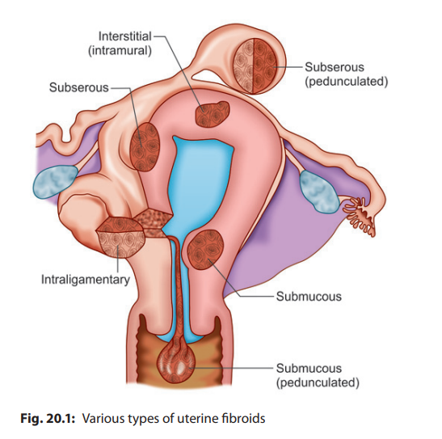

Slide 5
RISK FACTORS FOR FIBROID
Increased risk --- Nulliparity , Obesity, body mass index (BMI), Polycystic ovary syndrome (PCOS) , Hyperestrogenic state , Black women , High fat diet
Family history – Multiparity, Menopause, Combined oral contraceptives (COCs) use , Smoking

Slide 6
TYPES --- Body Cervical
Body The fibroids are mostly located in the body of the uterus and are usually multiple .There are three types-
1.Interstitial (intramural )-75%
2.subserous or subperitoneal 15 %
3.Submucous 5%
Cervical---1.anterior 2.posterior 3.central 4.Lateral

Slide 7
SECONDARY CHANGES IN A FIBROID
Degenerations
Atrophy
Necrosis
Infection
Vascular changes
Sarcomatous changes

Slide 8
COMPLICATIONS OF FIBROIDS
Degenerations
Necrosis
Infection
Sarcomatous change (rare)
Torsion of subserous pedunculated fibroid
Hemorrhage -- Intracapsular
Ruptured surface vein of subserous fibroid --- intraperitoneal hemorrhage
Polycythemia due to Erythropoietic function by the tumor-- Altered erythropoietic function of the kidney through ureteric pressure

Slide 9
SYMPTOMS OF FIBROID UTERUS
Asymptomatic—majority (75%)
Menstrual abnormality: Menorrhagia,
Subfertility
Pressure symptoms
Recurrent pregnancy loss (miscarriage, preterm labor)
Swelling of lower abdomen

Slide 10
effect of fibroid on Pregnancy- abortion, preterm labor and intrauterine growth restriction .
Effect of pregnancy on fibroid -
Red degeneration and torsion of subserous pedunculated fibroid is common in pregnancy.
During labour - Labor dystocia, increased operative delivery postpartum hemorrhage are also more.

Slide 11
Why menorrhagia occurs in fibroid ?
Increased surface area of the endometrium (Normal is about 15 cm2)
Interference with normal uterine contractility due to interposition of fibroid
Congestion and dilatation of the subjacent endometrial venous plexuses caused by the obstruction of the tumor
Endometrial hyperplasia due to hyper estrinism (anovulation)
Pelvic congestion
Role of prostanoids—imbalance of throm boxane (TXA2) and prostacyclin (PGI2) with relative deficiency of TXA2

Slide 12
Signs
General examination -anaemia.
Abdominal examination
But if enlarged to 14 weeks or more, the following features are noted-
Palpation - Feel is firm
Margins are well-defined
Surface is nodular; may be uniformly enlarged in a single fibroid
Mobility is restricted from above downwards but can be moved from side to side.

Slide 13
the swelling is uterine is evidenced by:
Uterus is not felt separated from the swelling and as such a groove is not felt between the uterus and the mass
The cervix moves with the movement of the tumor felt per abdomen.
The only exception of these two findings is a subserous pedunculated fibroid.

Slide 14
Diagnosis- 1.USG of lower abdomen is useful to confirm the diagnosis.
2.Saline infusion sonography
3.MRI
4.Laparocsopy is useful if uterine size is less than 12 weeks and associated with pelvic pain and infertility .

Slide 15
ASYMPTOMATIC MANAGEMENT (75%)
Fibroids detected accidentally on routine examination for complaints other than fibroids are dealt with as follows:
Observation Surgery
Observation: A certain diagnosis of fibroid should be a must .

Slide 16
Indications of expectant management:
Size <12 weeks
Diagnosis certain
Follow up possible
Periodic examination at interval of 6 months and ultrasound evaluation is needed.
If the symptoms of fibroid appear and or it grows and increases in size surgery is indicated .

Slide 17
SYMPTOMATIC MANAGEMENT
Medical Management
The drugs are used either as a temporary palliation or may be used in rare cases, as an alternative to surgery.
To Minimize Blood Loss ---As a temporary palliation, various drugs are used to minimize blood loss and to correct anemia when a definite surgery cannot be undertaken for certain periods

Slide 18
DRUGS USED TO MINIMIZE BLOOD LOSS
Antiprogesterones (Mifepristone)
Antigonadotropins: Danazol, gestrinone
GnRH analogs: Agonists Antagonists
LNG-IUS
Combined oral contraceptives (COCs)
Prostaglandin synthetase inhibitors
Selective progesterone receptor modulators (SPRMS)

Slide 19
Surgical Management of Fibroid Uterus
Myomectomy (may be done by) – Laparotomy, Laparoscopy , Hysteroscopy
Embolotherapy
uterine artery ligation
Myolysis
Endometrial ablation
Hysterectomy

Slide 20
Myomectomy -- Myomectomy is the enucleation of myomata from the uterus leaving behind a potentially functioning organ capable of future reproduction.

Slide 21
IMPORTANT CONSIDERATIONS PRIOR TO MYOMECTOMY
It should be done mainly when pt wants child .
Risk of recurrence and persistence of fibroid is about 30–50%
Risk of persistence of menorrhagia is about 1–5%
Risk of relaparotomy is about 20–25%
Pregnancy rate following myomectomy is about 40–60%
Pregnancy following myomectomy should have mandatory hospital
Delivery .

Slide 22
INDICATIONS OF MYOMECTOMY
Persistent uterine bleeding despite medical therapy
Excessive pain or pressure symptoms
Size > 12 weeks,
woman desirous to have a baby
Distortion of the uterine cavity without any other cause
Recurrent pregnancy loss due to fibroid
Rapidly growing myoma during follow-up
Subserous pedunculated fibroid

Slide 23
PREREQUISITES TO MYOMECTOMY
Hysteroscopy or hysterosalpingography—to exclude any submucous fibroid or a polyp or any tubal block
Hysteroscopy/endometrial biopsy—in cases of irregular cycles, not only to remove a polyp but also to exclude endometrial carcinoma
Husband s semen analysis

Slide 24
TAH is the definitive surgery.

