Slide 1
MALPOSITION

Slide 2
LIE: The lie refers to the relationship of the long axis of the fetus to the long axis of the centralized uterus or maternal spine, the most common lie being longitudinal (99.5%).
The lie may be transverse or oblique; sometimes the lie is unstable until labor sets in, when it becomes either longitudinal or transverse .

Slide 3
PRESENTATION: The part of the fetus which occupies the lower pole of the uterus (pelvic brim) is called the presentation of the fetus.
Accordingly, the presentation may be cephalic (96.5%), podalic (3%) or shoulder and other (0.5%).
When more than one part of the fetus present, it is called compound presentation

Slide 4
PRESENTING PART: The presenting part is defined as the part of the presentation which overlies the internal os and is felt by the examining finger through the cervical opening.
Thus, in cephalic presentation, the presenting part may be vertex (most common), brow or face, depending upon the degree of flexion of the head .
ATTITUDE: The relation of the different parts of the fetus to one another is called attitude of the fetus. The universal attitude is that of flexion

Slide 5
DENOMINATOR: It is an arbitrary bony fixed point on the presenting part which comes in relation with the various quadrants of the maternal pelvis.
The following are the denominators of the different presentations—occiput in vertex, mentum (chin) in face, frontal eminence in brow, sacrum in breech and acromion in shoulder.

Slide 6
POSITION: It is the relation of the denominator to the different quadrants of the pelvis.
For descriptive purpose, the pelvis is divided into equal segments of 45° to place the denominator in each segment. Thus, theoretically, there are 8 positions with each presenting part .
Anterior, posterior, right or left position is referred in relation to the maternal pelvis, with the mother in erect position.

Slide 7
Vertex occupying the left anterior quadrant of the pelvis is the most common one and is called left occipitoanterior (LOA). This is the first vertex position.
Similarly, right occipitoanterior (ROA) is the second vertex; right occipitoposterior (ROP) third vertex and left occipitoposterior (LOP) is the fourth vertex position .

Slide 8
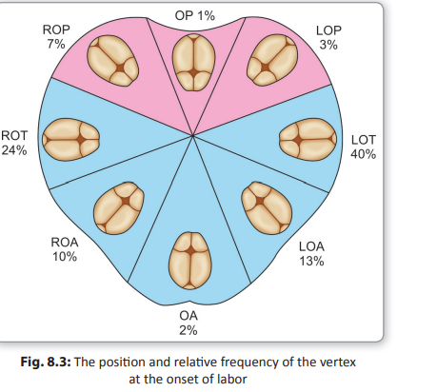

Slide 9
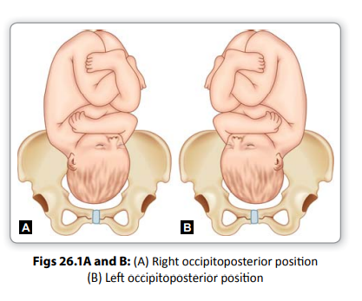

Slide 10
Malposition refers to any position of the vertex other than flexed occipito anterior one.
In a vertex presentation where the occiput is placed posteriorly over the sacroiliac joint or directly over the sacrum, it is called an occiput-posterior position.
When the occiput is placed over the right sacroiliac joint, the position is called right occipitoposterior (ROP), traditionally called third position of the vertex and
when placed over the left sacroiliac joint, is called left occipitoposterior (LOP), traditionally called fourth position of the vertex and
when it points toward the sacrum, is called direct occipitoposterior.
All the three positions may be primary (present before the onset of labor) or secondary (developing after labor starts)

Slide 11
Occiput-posterior is an abnormal position of the vertex rather than an abnormal presentation.
In majority of cases (90%), anterior rotation of the occiput occurs and follows the course like that of an occipitoanterior
Right occipitoposterior is five times more common than the left occipitoposterior.
Dextrorotation of the uterus and the presence of the sigmoid colon on the left disfavor LOP position.

Slide 12
ABDOMINAL EXAMINATION
Inspection: The abdomen looks flat, below the umbilicus.
Umbilical grip: The findings are:
(1) The fetal limbs are more easily felt near the midline on either side. (2) The fetal back is felt far away from the midline on the flank and often difficult to outline clearly.
(3) The anterior shoulder lies far away from the midline.

Slide 13
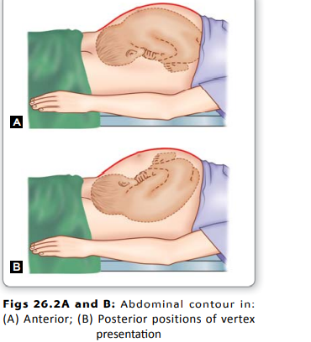

Slide 14
Pelvic grips: The findings are:
(1) The head is not engaged.
(2) The cephalic prominence (sinciput) is not felt so prominent as found in well-flexed occipitoanterior.
In direct occipitoposterior, the small sinciput is confused with breech.
Auscultation: The maximum intensity of the fetal heart sounds is heard on the flank and often difficult to locate especially in LOP.
However, in direct occipitoposterior, the FHS is distinctly felt in the midline.

Slide 15
VAGINAL EXAMINATION
The findings in early labor are:
(1) Elongated bag of membranes which is likely to rupture during examination.
(2) The sagittal suture occupies any of the oblique diameters of the pelvis.
(3) Posterior fontanel is felt near the sacroiliac joint.
(4) The anterior fontanel is felt more easily because of deflexion of the head and at times, is felt at a lower level than the posterior one.

Slide 16
In late labor, the diagnosis is often difficult because of caput formation which obliterates the sutures and fontanels.
In such cases, the ear is to be located and unfolded pinna points toward the occiput.
Simultaneous assessment of the pelvis should be done.
Imaging: Ultrasonography is rarely done. It is helpful to know the descent, attitude of the head and its relation to the pelvic walls (position)

Slide 17
The head engages through the right oblique diameter in ROP and left oblique diameter in LOP.
The engaging transverse diameter of the head is biparietal (9.5 cm) and that of anteroposterior diameter is either suboccipitofrontal (10 cm) or occipitofrontal (11.5 cm).
Because of deflexion, engagement is delayed.
In Favorable Circumstances (90%)

Slide 18
In Favorable Circumstances (90%)
Flexion:
Internal rotation of the head: As the occiput is the leading part, it rotates 3/8th of a circle anteriorly to lie behind the symphysis pubis.
. Further descent and delivery of the head occurs like that of occipitoanterior position
Restitution: There is movement of restitution to the extent of 1/8th of a circle in the opposite direction of internal rotation of the head.
External rotation: .
Birth of the shoulders and trunk

Slide 19
In unfavorable circumstances: (Nonrotation or malrotation)—10%.
In certain circumstances, the occiput fails to rotate as described previously
Incomplete forward rotation: In this condition, the occiput rotates through 1/8th of a circle anteriorly and the sagittal suture comes to lie in the bispinous diameter.
Thereafter, further anterior rotation is unlikely and arrest in this position is called deep transverse arrest

Slide 20
Nonrotation: Both the sinciput and the occiput touch the pelvic f oor simultaneously due to moderate deflexion of the head resulting in nonrotation of the occiput.
The sagittal suture lies in the oblique diameter.
Further mechanism is unlikely and the condition is called oblique posterior arrest.

Slide 21
Malrotation:
In extreme deflexion, the sinciput touches the pelvic floor first resulting in anterior rotation of the sinciput to 1/8th of a circle and putting the occiput to the sacral hollow.
This position is termed as occipitosacral position. This is, in the true sense, “Persistent Occipitoposterior Position” (POP) of the vertex.
In favorable circumstances, i.e. with an average size baby, good uterine contractions and an adequate pelvis such as an anthropoid or spacious gynecoid— spontaneous delivery may occur as “face to pubis”.
In unfavorable circumstances, when arrest occurs, it is called occipitosacral arrest

Slide 22
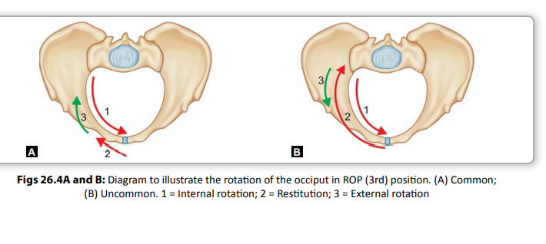

Slide 23
MANAGEMENT OF LABOR Principles:
— (1) early diagnosis,
(2) strict vigilance with watchful expectancy hoping for descent and anterior rotation of the occiput, and
(3) judicious and timely interference, if necessary.
Diagnosis and evaluation: Fetal back on the flank with the FHS not being easily located, early rupture of the membranes
.Internal examination is confirmatory

Slide 24
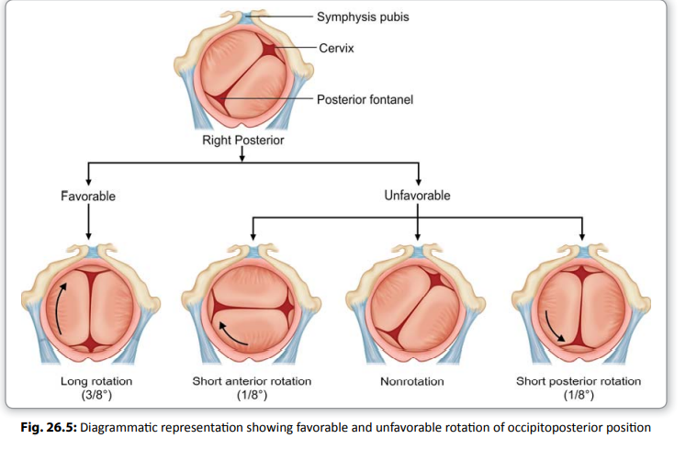

Slide 25
First stage: In otherwise uncomplicated cases, the labor is allowed to proceed in a manner similar to normal labor
Second stage: In majority, anterior rotation of the occiput is completed and the delivery is either spontaneous or can be accomplished by low forceps or ventouse
In minority (unrotated and malrotated): Provided the fetal and maternal conditions permit, one should take a watchful expectancy for the anterior rotation of the occiput ,
spontaneous delivery as face-to-pubis may occur. liberal episiotomy should be done.

Slide 26
I. ARREST IN OCCIPITOTRANSVERSE OR OBLIQUE OCCIPITOPOSTERIOR POSITION
(1) Ventouse (Vacuum extraction):
(2) Cesarean section: If the case is unsuitable for manual rotation especially in the presence of midpelvic contraction, cesarean section is much safer even at this stage.
(3) Alternative methods (a) Manual rotation followed by forceps extraction
b) Forceps rotation and extraction
C) Craniotomy: The dead baby should be delivered by craniotomy

Slide 27
II. OCCIPITOSACRAL ARREST
If the head is engaged and the occiput descends below the ischial spines, forceps application in unrotated head followed by extraction as face-to-pubis is an effective procedure.
Liberal mediolateral episiotomy should be done.
If the occiput remains at or above the level of ischial spines, cesarean section .

Slide 28
DEEP TRANSVERSE ARREST
Diagnosis: (a) The head is engaged, (b) The sagittal suture lies in the transverse bispinous diameter, (c) Anterior fontanel is palpable
Management:
(1) Vaginal delivery is found not safe (big baby and or inadequate pelvis): Cesarean section.
(2) Vaginal delivery is found safe (any of the methods may be employed):
(1) Ventouse (2) Manual rotation and application of forceps.

