Slide 1
ECTOPIC PREGNANCY

Slide 2
Definition
An ectopic pregnancy is one in which the fertilized ovum is implanted and develops outside the normal endometrial cavity.

Slide 3
Sites
EXTRA UTERINE-
  A)Tubal-97%-
    Ampulla (55% ),
    isthmus (25%),
    infundibulum (18%),
    interstitial (2%)
  B)Ovarian (.5% )
  C)abdominal( 1%)

Slide 4
UTERINE- (1.5%)
  A)Cervical (<1% )
  B)Angular
  C)Cornual
  D)caesarean section scar (<1%)

Slide 5
ETIOLOGY
1)Salpingitis and pelvic inflammatory diseases –increases the risk of ectopic pregnancy by 6-10 fold .
a)loss of cilia of lining epithelium and impairment of muscular peristalsis
b)Narrowing of tubal lumen
c)formation of adhesion between mucosal folds

Slide 6
2)Contraceptive failure –
  IUD –There is relative increase in tubal pregnancy (7 times more )should pregnancy occur with IUD in situ .
  Sterilization operation-There is 15-50% chance of being ectopic if pregnancy occurs .This is due to sterilization failure .
  Progesterone only pill or post-coital estrogen preparation increase the chance of tubal pregnancy probably by impaired tubal motility

Slide 7
3)Tubal surgery
4)ART
5)Previous ectopic pregnancy
6)Prior induced abortion
7)Tubal endometriosis

Slide 8
TYPES OF ECTOPIC PREGNANCY-
Acute ruptured ectopic
Unruptured
Subacute

Slide 9
RISK FACTORS OF ECTOPIC PREGNANCY
  History of PID
  History of tubal ligation
  Contraception failure
  Previous ectopic pregnancy
  Tubal reconstructive surgery
  History of infertility
  ART particularly if the tubes are patent but damaged
  IUD use
  Previous induced abortion
  Tubal endometriosis

Slide 10
Clinical features of ACUTE ectopic pregnancy-
Patient profile –maximum between age of 20 -30
Onset is acute
Symptoms-classic triad of symptoms-
1)Amenorrhea (75% ) Short period of amenorrhea (6-8)weeks
2)Abdominal pain –(100% )-It is the most constant feature .It is acute , agonising or colicky,Pain is located in lower abdomen .Shoulder tip pain (25%) may be present .
3)Vaginal bleeding (70%)
4)Vomitting,fainting attack (syncopal attack )

Slide 11
Signs-
General look –Diagnostic.the pt lies quiet and conscios,perspires and looks blanched.
Pallor-severe and proportionate to the internal haemorrage
Features of shock-pulse rapid and feeble,hypotension,extrimities –cold and clammy
Abdominal examination-
Abdomen (lower abdomen )-tense,tumid ,tender
No mass is usually felt
Shifting Dullness present
Muscle guard –usually absent.

Slide 12
Pelvic examination-Usually not done due to extreme tenderness and it may precipitate more haemorrhage .The findings are –
Vaginal mucosa-Blanched white
Cevical excitation test positive -extreme tenderness on fornix palpation or on movement of cervix
DIAGNOSIS OF ACUTE ECTOPIC---The classic history of acute abdominal catastrophe with fainting attack and collapse associated with features of intraabdominal haemorrhage in a woman of child bearing age points to ruptured ectopic.

Slide 13
Investigations-
A) Estimation of Hb % and blood grouping and Rh typing is done urgently .
B) Estimation of serum B-HCG -pregnancy test is positive in 95% cases.
1)lower conc of b-HCG than normal intrauterine pregnancy
2)doubling time in plasma fails to occur in 2days
C)Ultrasonography-
1)Absence of intrauterine pregnancy with a positive pregnancy test .
2)fluid in the pouch of Douglas .

Slide 14
Management of acute ectopic
Principle-Resuscitation and laparotomy simultaneously.
Ante shock treatment –Anti –shock measures are to be taken energetically with simultaneous preparation for urgent laparotomy .
Crystalloid solution is started.
Blood is sent for grouping and cross matching.At least 3-4 bags of blood should be ready .
In the meantime colloid solution is started.
Laparotomy followed by salpingectomy.if ovary is damaged beyond salvage then salpingo –oophorectomy is done.

Slide 15
Laparotomy-Indication of laparotomy are-
1)patient hemodynamically unstable
2)evidence of rupture
3)laparoscopy contra indicated

Slide 16
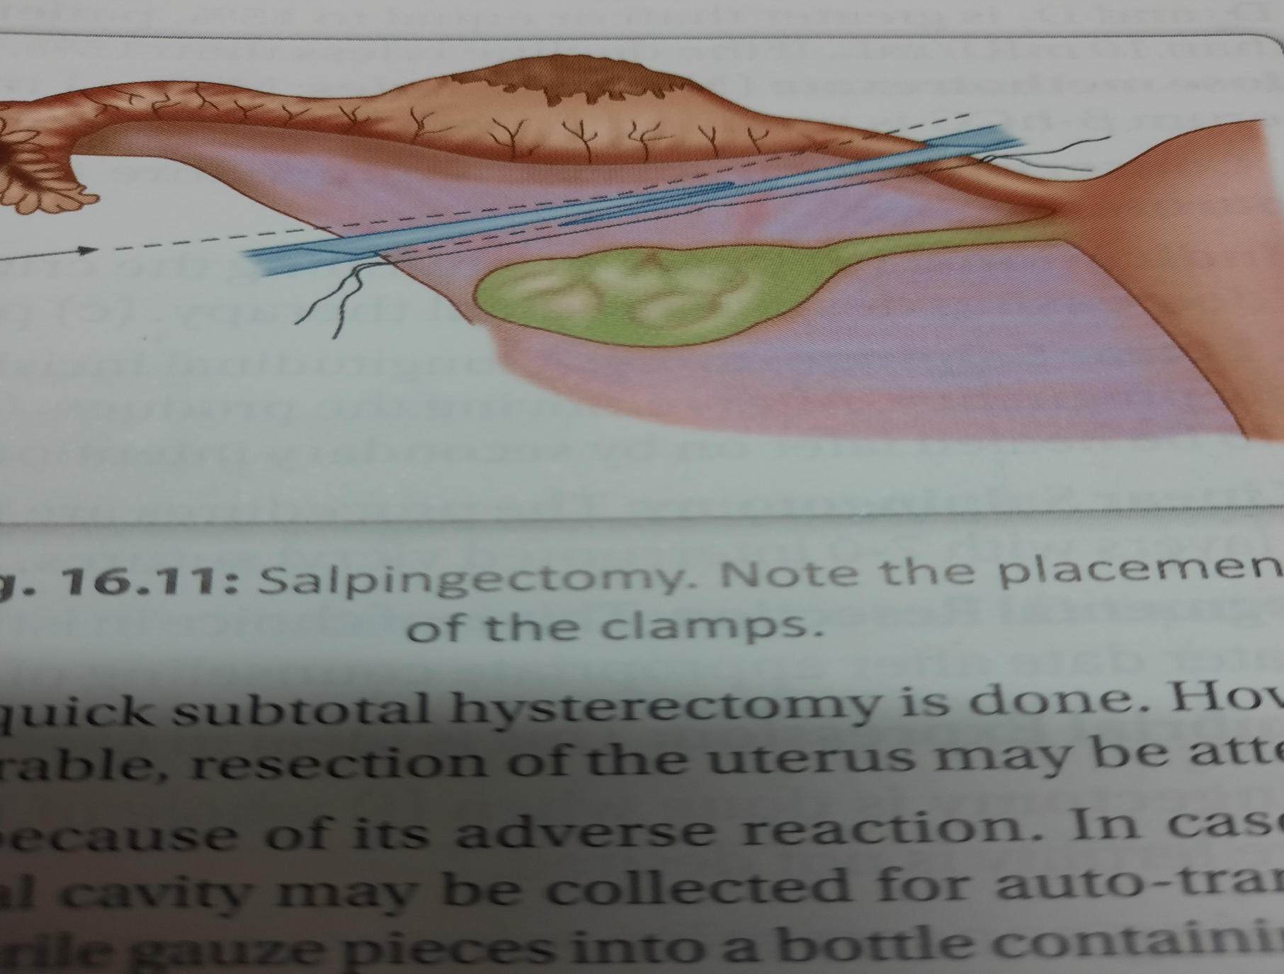

Slide 17
Management of unruptured ectopic pregnancy
Expectant management –where only observation is done hoping for spontaneous resolution.Indication are –
1)initial serum level <1500 IU/L
2)Gestational sac <4 cm
3)No fetal heart beat on TVS
4)No evidence of bleeding or rupture on TVS .

Slide 18
Medical Mx-1)Haemodynamically stable
2)serum hCG level <3000 IU/L
3)Tubal diameter <4 cm without any fetal cardiac activity
4)There should be no intra abdominal haemorrhage
The drugs commonly used for salpingocentesis are-
Methotrexate
Potassium chloride
Prostaglandin
Hyperosmolar glucose
Actinomycin

Slide 19
Conservative surgery-
Indications-
a)cases not fulfilling the criteria of medical therapy
b)Cases where B-hCG levels are not decreasing despite medical therapy
C) persistent fetal cardiac activity
1)Linear salpingostomy
2)linear salpingotomy
3)segmental resection
4)fimbrial expression

